Slide 1
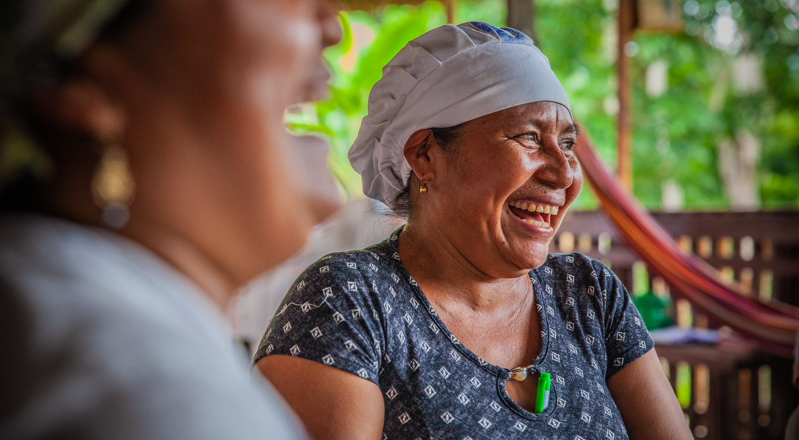
USAID CATALYZE Mobilizing Private Capital for Development
Year 3, Quarter 2 Report January 1, 2022 – March 31, 2022
PHOTO CREDIT: JACK GORDON FOR USAID/DIGITAL DEVELOPMENT COMMUNICATIONS

Slide 2
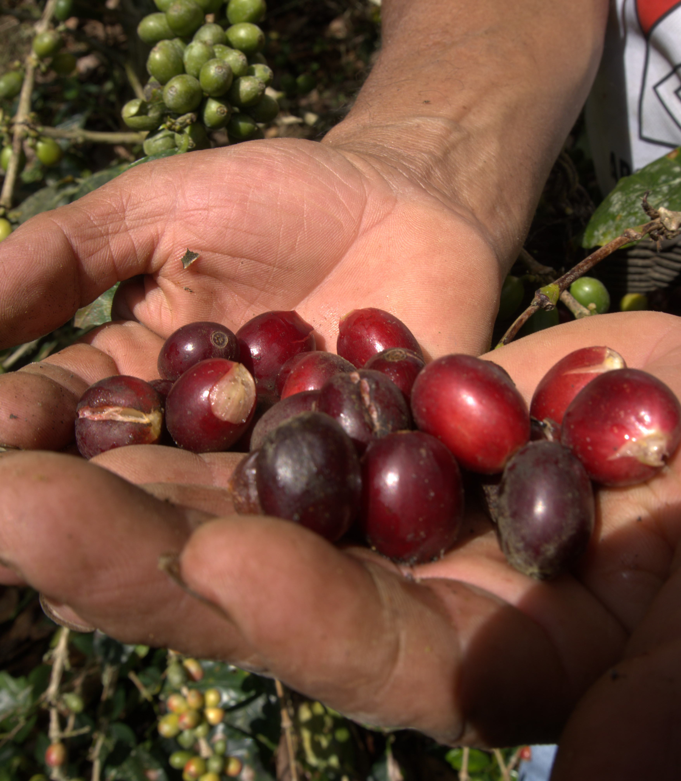
TABLE OF CONTENTS
Acronyms 3
Buy-In Summary 4
Introduction 5
CATALYZE Core Updates 8
Organization Chart 28
Activity Updates 30
EduFinance 30
Women’s Economic Empowerment (WEE) 39
MS4G 46
CATALYZE Peru 55
Private Sector Development (PSD) 60
Finance for Resilience (F4R) 64
Engines of Growth (EoG) 69
Asia – Social Protection 75
Spotlight 78
Financial Summary 82
CREDIT: CATALYZE PERU

Slide 3
ACRONYMS
AMELP Activity Monitoring, Evaluation, and Learning Plans
ASP Asia – Social Protection
BAS Business Advisory Services
BASP Business Advisory Service Providers
BYC Bridge Youth Connect
DFC Development Finance Corporation
EoG Engines of Growth
FF Financing Facilitators
F4R Finance for Resilience
FI Financial Institutions
GUC Grants under Contract
ICT Information, Communication, and Technology
IP Implementing Partner
KM Knowledge Management
LAC Latin American and the Caribbean
LOP Life of Project
MEL Monitoring, Evaluation, and Learning
MoU Memorandum of Understanding
MSMEs Micro-, Small-, and Medium-sized Enterprises
P4F Pay for Results
PSD Private Sector Development
RFA Request for Applications
RFP Request for Proposals
SME Small- and Medium-sized Enterprises
SP Social Protection
TBASP Technical Business Advisory Service Providers
TDY Temporary Duty Travel
USAID United States Agency for International Development
USD United States Dollar
USG United States Government
WEE Women’s Economic Empowerment
W-SMEs Women-owned Small- and Medium-sized Enterprises

Slide 4
USAID CATALYZE BUY-IN SUMMARY
EduFinance
Improve and sustain learning outcomes for children and youth, particularly those who are the most marginalized and vulnerable
Private Sector Development Promote economic diversification, COVID-19 recovery, and employment opportunities for women in Sri Lanka
Contract ceiling of USD250 M (base period USD169,179,520), of which USD105.22 million has been obligated
Oct 2019 – Sep 2024 (base period)
Asia, Africa,
Latin America and Caribbean, Western Balkans
Women’s Economic Empowerment
Mobilize capital to create economic opportunities for women
Finance for Resilience
Increase financing to support capital investment in the agricultural sector and in youth-led enterprises in Burkina Faso and Niger
MS4G
Foster private enterprise growth, primarily in agricultural markets, to create jobs and increase income in Ethiopia
Engines of Growth
Increase enterprise access to and use of finance to drive growth in Western Balkans
Peru
Catalyze investment and access to finance in the Peruvian Amazon
Asia – Social Protection
Improve access to financial and social protection for vulnerable women in Asia
CREDIT: GIFT HABESHAW

Slide 5
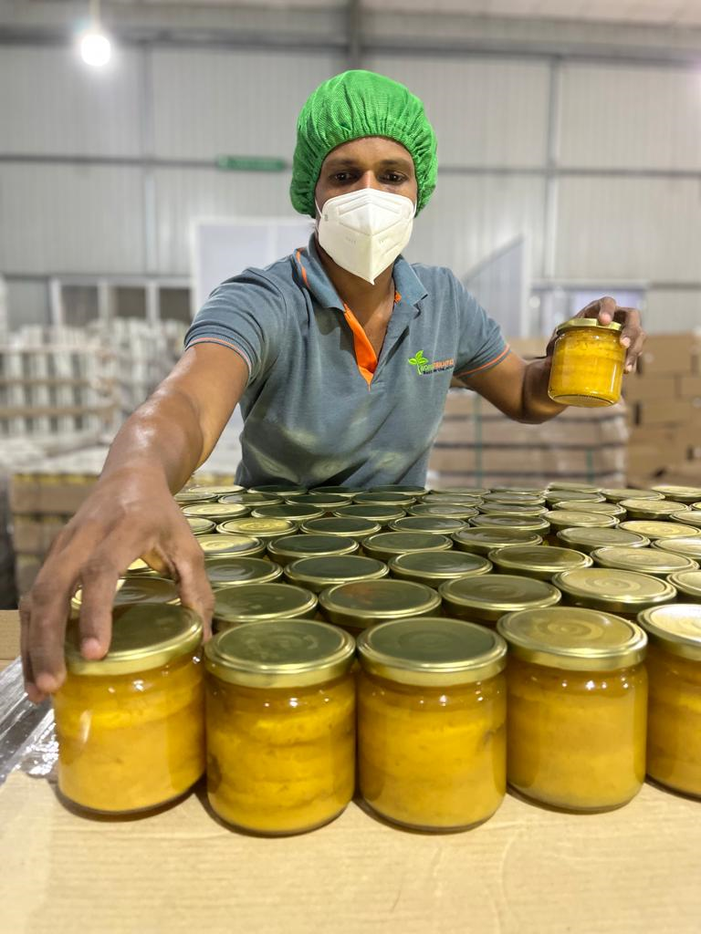
INTRODUCTION
20 USAID missions financially contributing to program Buy-Ins
Approximately USD1.2 billion in capital mobilization targets for base five years (with possible 3-year extension)
27 countries in Asia, Africa, Latin America and Caribbean (LAC), and Western Balkans
Sectors – Green finance, education, financial, agriculture, information and communications technology (ICT), tourism, healthcare, commercial care, garments, social protection, infrastructure, small and medium enterprises (SMEs) across sectors
Cost Plus Award Fee contract-type for activities incentivizes achievement of results and use of pay-for-results-type mechanisms
Engagement mechanisms focus on grants under contract (GUCs) and subcontracts, as well as others
Focus on wholesale platform approaches to deploying blended finance at scale in countries where USAID is present
USAID CATALYZE, implemented by Palladium, works with businesses, investors, and other key market actors to solve the world's most pressing challenges. We seek to unlock private sector financing for development impact, especially in underserved social sectors and frontier countries, using up to USD250 million in catalytic capital from USAID.
PHOTO CREDIT: CATALYZE PSD

Slide 6
ACTIVITY SUMMARY
20 USAID Missions Financially Supporting CATALYZE
USAID Africa (Sustainable Development)​
USAID Asia​
USAID Burkina Faso (Sahel)​
USAID Democratic Republic of Congo (Education)
USAID Democracy, Conflict, and Humanitarian Assistance Bureau​ (Education)
USAID Ethiopia​
USAID Europe and Eurasia/Western Balkans​
USAID HQ – Education​
USAID HQ – Private Sector Engagement Hub​
USAID Kenya (Education)​
USAID LAC Regional Bureau (Education)​
USAID Niger (Sahel)​
USAID Peru​
USAID Rwanda (Education) ​
USAID Sahel​
USAID South Africa (Education)​
USAID Sri Lanka
USAID Tanzania (Education)​
USAID Zambia (Education)
Women’s Economic Empowerment (WEE)
CREDIT: GIFT HABESHAW

Slide 7
USAID CATALYZE
CATALYZE Core Updates
CREDIT: VIANNEY CARRIERE

Slide 8
CATALYZE CORE UPDATES (Y3 Q2)
Highlights for Year 3, Quarter 2
During the reporting period, technical assistance provided across activities has enabled CATALYZE activities to design and operationalize blended finance approaches that led to the mobilization of USD18.9 million in debt-financing from 23 financial institutions for eight schools and 655 firms (of which 46% are female-owned firms) in six countries (Burkina Faso, Ethiopia, North Macedonia, Peru, Serbia, and South Africa).
As of March 31, 2022, CATALYZE has issued a cumulative total of USD11.14 million in grants to 86 awardees (of which 94.18% are local grantees) and an additional USD21.12 million in subcontracts above the micro-purchase threshold (USD10,000) to 134 partners (of which 62.68% are local awardees), to provide services across all CATALYZE buy-ins to achieve technical targets and blended finance solutions.
CATALYZE continued to re-shape project teams to support management decentralization in support of localization and is sending TDYs to the field for additional capacity-building trainings in the next quarter.
CATALYZE organized a learn and review session on the definition of "Private Capital Mobilization" and the verification instruments that are agreed upon with USAID. The session highlighted best practices based on CATALYZE's recent experience and how to best use new measurement methodologies.
The communications team supported all eight CATALYZE activities in developing individual fact sheets and landing pages.
The Gender Smart Investing Specialist provided technical support in gender lens investing across activities and is working with CATALYZE activities to develop individual gender strategies.
The Investment Lead will serve as liaison to DFC to increase CATALYZE utilization of DFC investment products and strengthen USAID - DFC collaboration. The Investment Lead also provided customized financing, investment, structuring, capital raising, and technical evaluation support to all eight CATALYZE activities.
The CORE team continued the design and delivery of onboarding trainings for project staff and held a session on USAID branding and marking requirements this past quarter. Training sessions are available in video format for new hires.

Slide 9
CATALYZE CORE UPDATES (Y3 Q2)
Programmatic Trends
Salient trends that can be distilled from major activities in process
Capital mobilization results are ramping up as expected following an intensive period of design and procurement, reaching USD42.2 million cumulative capital mobilized. Most of the capital mobilized by CATALYZE is in Europe and Africa, followed by Latin America.
The most common blended finance, pay-for-result incentive used across all CATALYZE Activities is Business Advisory Services (BAS), although half of all Activities will be applying FI incentives.
Debt is the predominant form of capital mobilized for businesses supported by CATALYZE, with factoring as an important, emerging product among two Activities.
Cumulative private capital mobilized is principally in the agriculture sector (37% of all capital mobilized by CATALYZE), followed by manufacturing (35%), commerce (16%) and tourism (5%).
Forty-one percent of all firms supported by CATALYZE are women-owned, however women-owned businesses constitute (13%) of all SMEs receiving cumulative financing support under CATALYZE. We expect this percentage to increase with the rollout of gender action plans for each Activity.
CATALYZE is supporting a range of business sizes with financing and other supports, from microentrepreneurs to schools to large enterprises, with micro and small enterprises representing the largest group receiving support (73%), but small- and medium-sized enterprises accessing the highest volume of capital. This quarter, 873 entities received support from CATALYZE, including 662 firms, 210 schools and one association.
After participating in co-creation of performance work statements for CATALYZE Activities, USAID mission personnel are updated on a weekly, monthly, and quarterly basis with progress reports from each of the CATALYZE activities, thereby improving institutional capability and understanding of how private sector engagement and capital mobilization programming are managed.

Slide 10
CATALYZE CORE UPDATES
Administrative and Bureaucratic Issues and Solutions
Issues
The level of staff turnover within CATALYZE Activity Management Units in the Palladium home office is high, mirroring larger employment trends within the American economy during the period of COVID-19 recovery.
High levels of inflation and devaluation of local currency vs. the U.S. Dollar are contributing to staff turnover in field offices of CATALYZE’ programs in Sri Lanka and Ethiopia.
While Palladium and USAID have agreed to the process by which programmatic fee is calculated, we have not yet billed any related fee for Years 1 and 2, influencing revenue expenditure levels.
Solutions
CATALYZE Core management is ramping up recruitment together with Activity Management Units (AMUs), implementing agile team solutions to manage workload during turnover. We are further intensifying staff performance review processes to anticipate and prevent turnover when possible.
CATALYZE AMUs are conducting equity reviews of salaries based on local market conditions and are consulting with relevant USAID missions to develop solutions to devalued salaries of field-based staff paid in local currency, in line with United States Government (USG) regulations.
Palladium and USAID are in conversations to finalize the process by which eligible fee amounts will be requested to USAID. We plan to complete conversations and have a final process by June 2022.

Slide 11
PRIVATE CAPITAL MOBILIZED (Y3 Q2)
During the reporting period, all eight CATALYZE activities collectively designed and operationalized blended finance approaches that led to mobilization of USD18.9 million in debt-financing for eight schools and 655 firms (of which 46% are female-owned firms) in six countries (Burkina Faso, Ethiopia, North Macedonia, Peru, Serbia, and South Africa).
A much larger sum of private capital (USD297,487,497) is poised for closure in the coming years, given that it is structured into 92 approved results-based agreements, contracts, and memorandum of understandings (MoUs) with financial intermediaries. These intermediaries include business advisory service providers (BASPs), implementing partners (IPs), financial institutions (FIs), private anchor firms, and individual financing facilitators (FFs).
Activity | This Quarter |  |  | Cumulative
 | # of firms supported | Capital Mobilized (USD) | % of target | # of firms supported | Capital Mobilized (USD) | % of target
Catalyze Peru | 566 | 4,236,042 | 22% | 574 | 7,820,496 | 18%
EduFinance –South Africa | 8 | 26,703 | 1% | 8 | 26,703 | 1%
EduFinance –Zambia | - | - | - | 1 | 625,000 | 2%
MS4G | 3 | 4,932,314 | 26% | 6 | 10,023,484 | 24%
F4R | 58 | 1,184,979 | 6% | 110 | 13,305,370 | 4%
EOG | 20 | 8,605,728 | 45% | 50 | 21,911,098 | 51%
Total | 655 | 18,985,766 | 100% | 749 | 42,263,815 | 100%

Slide 12
PRIVATE CAPITAL MOBILIZED
(Y3 Q2)
Disaggregated by Activity
This quarter, all capital mobilized was in the form of debt and for purposes of the report is denominated in USD. Most of the capital mobilized was raised for small- and medium-sized enterprises. Businesses funded this quarter were concentrated in Europe, Peru, and the Sahel region, and predominantly in the agriculture, commerce, manufacturing, and hospitality sectors.
Disaggregated by Firm Size
Disaggregated by Firm Owner's Sex
68.5% USD13,004,190 Male Owned | 20.3% USD3,854,873 Female Owned | 11.1% USD2,100,00 Jointly Owned | .1% USD26,703 Unknown
Disaggregated by Financing Type
Disaggregated by Sector
100% USD18,985,766 Debt | 0% USD Non-debt/ Equity
45.8% Agriculture USD8,699,327 | 27.4% Manufacturing USD5,197,921 | 12.4% Commerce USD2,348,398 | 11.3% Hospitality USD2,150,171 | 1.3% Construction USD243,939 | 1.3% Other USD252,494 | 1% ICT USD39,564

Slide 13
PRIVATE CAPITAL MOBILIZED (Y3 Q2)
Number of Firms
By Activity
655
Firms and
Schools Received Financing
A total of 655 private businesses (of which 46% are women-owned firms) secured financing support during the reporting period. These 655 private businesses includes 647 firms and 8 schools. CATALYZE is not treating schools as firms hence we are not collecting information on breakup by school owner’s sex or school size. Furthermore, 17 financial institutions received or continue to receive assistance from CATALYZE.
 | 566 CATALYZE Peru 65%
 | 8 EduFinance – South Africa 1%
 | 58 F4R 7%
 | 20 EOG 2%
 | 3 MS4G 0.5%
By Firm Owner’s Sex
By Firm Size

Slide 14
PRIVATE CAPITAL MOBILIZED (Y3 Q2)
This quarter, 23 FIs and 133 intermediaries (e.g. BAS, anchor firms, individual consultants, nonprofits, consulting firms and other transaction advisors) were responsible for mobilizing USD18.8M in private financing for CATALYZE. Of this amount, CATALYZE direct engagements with FIs (e.g. incentive based grants, Memorandums of Understanding, other subawards) resulted in 34% of the financing released, whereas 64% of the private capital released by FIs to MSMEs was facilitated by intermediaries.
Activity | Fi | Intermediaries | Total
Sahel | $177,746.85 | $1,007,232.15 | $1,184,979.00
MS4G | $4,932,314.00 | $0.00 | $4,932,314.00
Peru | $1,355,533.44 | $2,880,508.56 | $4,236,042.00
EduFinance | $0.00 | $26,703.00 | $26,703.00
EOG | $0.00 | $8,605,728.00 | $8,605,728.00
Total | $6,465,594.29 | $12,520,171.71 | $18,985,766.00
 | 34% | 66%

Slide 15
NUMBER OF FIRMS ASSISTED (Y3 Q2)
By Activity
 | 566 CATALYZE Peru 65%
 | 8 EduFinance – South Africa 1%
 | 58 F4R 7%
 | 19 PSD 2%
 | 202 EduFinance – Zambia 23%
 | 20 EOG 2%
873
Firms and
Schools Assisted
A total of 873 private businesses (of which 35% are women-owned firms) benefited from the technical assistance and/or financial services support during the reporting period. This includes 662 firms, 210 schools, and one association, CATALYZE.
By Owner’s Sex
By Firm Owner’s Sex
By Firm Size

Slide 16
PRIVATE CAPITAL MOBILIZED (Cumulative)
Disaggregated by Activity
To date, the majority of capital mobilized was in the form of debt with most of the capital mobilized for small- and medium-sized enterprises. This slide shows the breakup of USD42 million in financing disaggregated by firm owner’s sex, financing type, sector, firm size, and activity.
Disaggregated by Firm Size
Disaggregated by Firm Owner's Sex
76.70% USD32,415,849 Male Owned | 13.14% USD5,552,279 Female Owned | 10.10% USD4,268,985 Jointly Owned | .06% USD26,703 Unknown
Disaggregated by Financing Type
Disaggregated by Sector (Cumulative)
89.06% USD37,638,815 Debt | 10.94% USD4,625,000 Non-debt (Equity & Grants)
37.10% Agriculture USD 15,680,202 | 34.64% Manufacturing USD 14,641,486 | 15.98% Commerce USD 6,754,040 | 5.09% Tourism USD 2,150,171 | 1.66% Construction USD 699,952 | 1.54% Education USD 651,703 | 0.06% Health USD 27,249

Slide 17
PRIVATE CAPITAL MOBILIZED (Cumulative)
Number of Firms
By Activity (Cumulative)
749
Firms and
Schools Received Financing
A total of 749 private businesses (of which 40.72% are women-owned firms) benefited from financing support during the reporting period. These 749 private businesses includes 717 firms and 8 schools (24 are unknown, pending verification).
574 CATALYZE Peru 74.64% | 110 F4R - Sahel 14.69%
8 EduFinance – South Africa 1.07% | 1 EduFinance – Zambia 0.13%
6 MS4G – Ethiopia 0.80% | 50 EOG – Western Balkans 6.68%
0 EduFinance – DRC 0% | 0 Sri Lanka – PSD 0%
By Owner’s Sex (Cumulative)
By Firm Size (Cumulative)

Slide 18
NUMBER OF FIRMS ASSISTED (Cumulative)
By Activity (Cumulative)
1,162
Firms and
Schools Assisted
A total of 1,162 private businesses (of which 33.13% are women-owned firms) benefited from the technical assistance and/or financial services support during the reporting period. This includes 859 firms, 210 schools, and one association. (92 unknown, pending verification)
574 CATALYZE Peru 49.40% | 110 F4R 9.47%
8 EduFinance – South Africa 0.69% | 202 EduFinance – Zambia 17.38%
194 MS4G 16.70% | 38 EOG 3.27%
0 EduFinance – DRC 0% | 36 PSD 3.10%
By Owner’s Sex (Cumulative)
By Firm Size (Cumulative)

Slide 19
CATALYZE CORE UPDATES (Y3, Q2)
Procurement at a Glance
CATALYZE uses a range of procurement tools to support capital mobilization and blended finance objectives across all activities. These include the following:
Indefinite Delivery Indefinite Quantity (IDIQ) Contracts
Cost Plus Fixed Fee Contracts
Blanket Purchase Agreements (BPA)
Firm Fixed Price Contracts
Consulting Agreements (CA)
Task Orders (TO)
Purchase Orders (PO)
Fixed-Price Task Orders
BPA Blanket Purchase Agreement
CA Cooperative Agreement
CPFF Cost Plus Fixed Fee
FFP Firm Fixed Price
ICA Individual Consultant Agreement
IDIQ Indefinite Deliverable Indefinite Quantity
PO Purchase Order
TM Time and Material
TO Task Order

Slide 20
CATALYZE CORE UPDATES (Y3, Q2)
Grants Under Contract (GUCs)
at a Glance
As of March 31, 2022, CATALYZE has issued a cumulative total of USD11.14 million in grants to 86 awardees (of which 94.18% are local actors) to provide services across all CATALYZE activities.

Slide 21
CATALYZE CORE UPDATES (Y3, Q2)
Cumulative Number of Subcontract Solicitations by Buy-in (562)
Procurement at a Glance
As of March 31, 2022, CATALYZE had issued USD21.12 million in subcontracts above the micro purchase threshold (USD10,000) to 134 partners (of which 62.68% are local actors) to provide services across all CATALYZE activities for monitoring and evaluation, education finance learning support, and transaction advisory support.

Slide 22
CATALYZE CORE UPDATES (Y3, Q2)
Communications
Communications Strategy Activities and Products
Fact Sheets for all buy-ins were developed and are in the approval process. The Engines of Growth (EOG) Fact Sheet has been approved. The EduFinance LAC Fact Sheet was developed and published on USAID EduFinance website.
A COVID Fact Sheet was developed and published on Medium and shared via social media and Palladium’s newsletters.
Website landing pages were written for all the buy-ins and are in the approval process. The Peru landing page was approved for posting.
Peru met with multiple partners and beneficiaries on field visits, capturing stories for communications materials and social media posts.
MS4G contracted a videographer to develop four 3-4 minutes promotional video documenting the goals, objectives, achievements and success stories of the project. During this quarter, MS4G also developed four creative briefs and four scripts.
Private Sector Development (PSD) also developed several videos, a two-pager highlighting grantees, and issued a press release on the MoU signing with DFC.
EduFinance facilitated a stakeholder input session as part of its communications strategy development (February 2022) and submitted a draft strategic communications plan to USAID for technical concurrence. EduFinance also developed an infographic for the LAC region in March to be submitted to USAID for approval in early April.

Slide 23
CATALYZE CORE UPDATES (Y3, Q2)
Communications, continued…
CATALYZE Press and Announcements
Peru was highlighted in the Green Protocol Bulletin, which is shared with all members of the Peruvian Banking Association. The activity’s partnership with grantee NESsT was also highlighted in a press release.
Women’s Economic Empowerment (WEE) published a blog on Market Links, titled “Women to Lean On: Financing for Women, by Women,” highlighting the work EoG is undertaking to strategically reach women-owned small- and medium-sized enterprises (W-SMEs).
MS4G developed and shared press release on a Cloud Computing Business Investment study.
A Finance for Resilience - Sahel (F4R) success story was written and published on Medium, which was shared widely by the U.S. Embassy in Burkina Faso on Facebook. The post received more than 1,900 “likes” and was shared 27 times. The story also appeared on SAFIN Network’s website and in Palladium’s Insider+ newsletter.
EduFinance facilitated an interview/blog post on GenDev’s MarketLinks (posted in March).
Events
WEE presented its activity design and approach on a webinar hosted by the USAID Finance and Investment Network. WEE grantee Sarona Asset Management presented on the Sarona Sustainable Global Growth Markets Fund. WEE grantee Sarona Asset Management presented on the Sarona Sustainable Global Growth Markets Fund.

Slide 24
CATALYZE CORE UPDATES (Y3, Q2)
Monitoring, Evaluating and Learning (MEL)
Activity | AMELP Status (as of March 2022)
Asia Social Protection | To be drafted after approval of concept note
CATALYZE Portfolio | Approved
CATALYZE Peru | Approved
EduFinance Portfolio | Received activity lead’s concurrence, awaiting COR's Approval.
EduFinance DRC | Approved
EduFinance Rawanda | Approved
EduFinance South Africa | Approved
EduFinance Zambia | Approved
MS4G | Approved
F4R | Approved
PSD | Approved
EoG | Approved
WEE | Submitted, awaiting COR’s comments on first draft.
CATALYZE’s Monitoring, Evaluation, and Learning (MEL) & Knowledge Management (KM) Director, with technical support from the Moonshot Global team, supported CATALYZE activities this quarter to improve draft activity management, evaluation, and learning plans (AMELPs) for several CATALYZE activities by incorporating USAID feedback. CATALYZE received Activity Leads’ concurrence of AMELPs for CATALYZE Peru, EduFinance Rwanda, EduFinance Portfolio, and PSD Activities. The final version of the EduFinance Portfolio AMELP and first draft of the Women’s Economic Empowerment (WEE) plan were shared with COR’s for review and approval.
In the next quarter, CATALYZE will revise AMELPs for EOG and MS4G considering the changes in the program work statement (PWS) of these Activities. The CATALYZE Portfolio MEL plan will also be updated to align with activities’ AMELPs.

Slide 25
CATALYZE CORE UPDATES (Y3, Q2)
Collaboration, Learning and Adaptation (CLA)
Collaboration
ASP planned a co-creation activity in the Philippines for the last week of April.
WEE Activity Lead traveled to Ecuador for a two-day co-creation workshop with Banco Pichincha to explore the possibility of collaboration. WEE also finalized the development of the POS-based lending product manual with BAC through a series of co-creation workshops and trainings, ensuring that the new product was responsive to BAC’s needs and concerns.
On March 9, Peru hosted a workshop with key stakeholders including digital service providers and actors in the value chain of the Peruvian Amazonia to generate dialogue and gather information for its mapping of the digital ecosystem of the region.
Learning
CATALYZE Core On March 25, CATALYZE Chief of Party and Director, MEL & KM led a “Learn and Review” session for CATALYZE staff and field teams on the definition of Private Capital Mobilized (PCM), incorporating the latest iteration on the subject with CATALYZE’s USAID Contracting Officer’s Representative (COR) who is part of the USAID Private Sector Engagement (PSE) team.
CATALYZE drafted an initial concept note to design and hold a series of Activity-level learning events and a virtual CATALYZE portfolio Learning Conference to be held during June to December 2022. The concept note will be finalized in collaboration with the CATALYZE COR in the next quarter.
EOG – In February, the team held sessions with the BASPs of Serbia and North Macedonia that are collaborating with the EoG Activity. The findings recommended modifying fees to incentivize BASPs to help reach W-SMEs and expand the BASP network in Macedonia to move away from working predominantly with micro-sized firms.

Slide 26
CATALYZE CORE UPDATES (Y3, Q2)
Collaboration, Learning and Adaptation (CLA), continued
Learning
Peru – The Activity Lead traveled to Peru and hosted a series of mid-project pause and reflect workshops with the team to assess the activity’s accomplishments to date and to adjust its strategic plan accordingly. The MEL lead is designing a learning agenda workshop to be held in the upcoming quarter.
MS4G – This quarter, the MEL team:
Conducted Learning Agenda sessions with different service providers and the technical team to discuss and reflect on the MS4G project Year I (2021) and 1st quarter of Year II (2022) implementation.
Worked with the MS4G technical team to develop learning questions, identify target respondents, conduct Key Informant Interviews (KIIs) with target respondents, reviewed relevant project documents, and analyze project data from routine trackers.
Is developing a pause and reflect session to identify which project activities have shown significant results/impact and which activities will need adapting.
WEE – continues to integrate pause and reflect learning opportunities into its bi-weekly meetings with USAID to determine what is working well and to explore ways to improve.
Adaptation
EOG – Based on the feedback from “Learn and Review” sessions with BASPs, EoG is adapting its approach to help expand the BASP network, promote BASP successes through the Activity and connect BASPs to organizations with similar mandates to extend the reach of BASPs to additional clients, especially W-SMEs.

Slide 27
CATALYZE CORE UPDATES (Y3, Q2) Staffing
CATALYZE Core team: The new Communications Director joined in March 2022, and the new CATALYZE Manager for Crosscutting Communications began work in mid-March 2022. We also completed the hiring of Manager, Project Communications; she will join CATALYZE in mid-April 2022.
EduFinance: A new Activity Lead began work in January 2022. EduFinance is currently recruiting for a Project Associate role and short-term technical assistance consultants to provide field implementation support and oversight. The recruitments for these open positions will be completed in the next quarter.
WEE: At the beginning of the quarter, a new Project Manager joined the team. The WEE team is currently recruiting for a Project Associate, which it intends to fill next quarter.
MS4G: In February 2022, MS4G completed the hiring and onboarding of Regional Coordinators for Hawassa and Bahir Dar. A WASH Advisor/Consultant was hired to provide short- to long-term support. MEL Specialist final candidate due diligence and the Grants Manager interviews are underway.
F4R: There are no staff updates during the quarter for Burkina Faso or Niger.
CATALYZE Peru: This quarter a new Activity Lead joined CATALYZE Peru along with a new Project Manager.
EoG: During this reporting quarter, EoG recruited two Access to Finance Administrators, including one for Serbia who will oversee the implementation of Window I activities in Serbia, Bosnia, and Montenegro, and one for Kosovo who will support Window 1 activities in Kosovo and Albania.
PSD: Two new hires joined the team (Activity Deputy Team Lead and MEL Manager). The Director of Operations now also serves as Director of Grants and Finance. In addition, the PSD Activity Team Lead was confirmed by USAID.
Asia Social Project (ASP): A newly recruited Senior Associate joined the team, providing excellent research into potential sources of private capital and other activities.

Slide 28
CATALYZE ORGANIZATION CHART
Nearly 120 staff: 79 in country and 38 based out of Palladium Americas office in DC
Amanda Fernandez
Executive Director/COP
Amanda Grevey
DCOP
Akbar Ahmadzai
Project Manager, CORE
Turner Hirsh
F&C Director (DFC)
Julie Abrams
Investment Lead
Shahzad Tahir
Director, Monitoring, Evaluation and Thought Leadership
Dr. Gaamaa Hishigsuren
Gender-Smart Investing Specialist
Laura McCarty
Director, Communications
Ashlee Cox
Sr. Associate, CORE
Mohammad Forotan
Sr. Associate, Finance
Victoria Baltazar
Procurement and Subcontracts Senior Manager
Zabiullah Ahmadyar
Grants Manager
Mohammad Gouhar
Finance Manager
Dustin Benedict
Manager,
Cross-cutting Communications
Carly Anderson
Manager, Project Communications
ACTIVITY MANAGEMENT UNITS (AMU)
EduFinance
Asia
WEE
Sahel
Sri Lanka
MS4G
Peru
Western Balkans
Michael Tetelmen
Activity Lead
Thierry van Bastelaer
Activity Lead
Gaamaa Hishigsuren Activity Lead
Lauren Rawling Activity Lead
Sachin Gupta
Activity Lead
Brett Johnson Activity Lead
Ignacio Estevez Activity Lead
Cinar Akin Activity Lead
Kathryn Smith
Deputy EduFinance Director
Brian Oh Project Manager
Kathleen Wilson
Project Manager
Ibrahima Djibo
Team Lead
Minnie Lanting Project Manager
Juan Forero
Team Lead
Julia Uriarte
Project Manager
Yohannas Assefa Country Director
Elisa Burrows Project Manager
Javier Freyre Country Director
Kathleen Wilson Project Manager
Dina Karic Team Lead
Brian Oh Project Manager
Elise Lang Technical Advisor
TBD
Associate
Country staff
Katharine Desgans Associate
Country staff
Emma Grant Associate
Genet Menelik Deputy Country Director
Katharine Desgans Associate
Country staff
Alejandro Macias Associate
Country staff
Emma Grant Associate
Maria Sabillon Project Manager
Kayla Mara Research Associate
Country staff
Ashraf Hammad Associate
Core Technical Team
Finance & Compliance Team
Core PMU
AMU
Activity Lead
Host Country Position
Sabine Sussman Analyst

Slide 29
USAID CATALYZE
Activity Updates
PHOTO CREDIT: Ishani Jayamaha

Slide 30
EDUFINANCE
Activity summary: Improve and sustain learning outcomes for children and youth, particularly those who are the most marginalized and vulnerable
Objectives
Mobilize private finance in a financially sustainable manner for non-state education sector, including low-fee private schools, skills development centers, and other education enterprises
Measurable increase in equitable access and improvement in learning outcomes, especially for the disadvantaged, and basic skills development for youth
Improve enabling environment for non-state education sector to strengthen the entrepreneurial ecosystem for education and improve sustainability
Build a community of practice (CoP) to lead collaborative engagement among diverse stakeholders (e.g., governments, education practitioners, investors, and civil society), strengthen and communicate broadly the evidence base around a common learning agenda for greater private sector engagement in education, and enable all stakeholders to make data-driven decisions
Identify and support innovative transactions in the education sector in sub-Saharan Africa and build a pipeline of transactions that facilitates longer term flow of capital to the sector
Projected life of project (LOP) budget of USD50.5 M, of which
USD43.75 M are obligated
Capital mobilization target of USD90.7 M
Oct 2019 – Sep 2024
Democratic Republic of Congo, Dominican Republic, El Salvador, Guatemala, Haiti, Kenya, Paraguay, Rwanda, Somalia, South Africa, Tanzania, and Zambia
Kaizenvest, UBS Optimus Foundation, Promoting Equality in African Schools, Education Partnerships Group, Opportunity International, and Fundación Paraguaya

Slide 31
EduFinance
Quarterly Updates (Y3 Q2)
1,000 learners in 202 schools (public and private) received USG assistance.
67% of secondary
students in those schools passed their exams.
174 educators completed professional development activities with USG assistance.
Zambia
Completed staff trainings with financial institution partner, NatSave, and began piloting additional EduFinance loan products with partner AB Bank after a successful initial launch in November 2021.
Organized teacher-mentor professional development training sessions and school leadership development training sessions with partner schools enrolled in CATALYZE EduFinance EduQuality improvement programming.
Engaged with the Ministry of Education and Ministry of Health to help with ongoing vaccination drives, including incorporating vaccine awareness into programming to dispel myths and misinformation.
Expanded access for secondary education in hard-to-reach communities. The majority of enrolled students are girls. CATALYZE EduFinance saw high re-enrollment for primary and secondary students at the start of the 2022 academic year, and results from 2021 secondary school exams yielded strong results that exceeded national averages.
Conducted eight interviews with Ministry of Education officials and held a policy workshop with government stakeholders to strengthen the enabling environment and policy structure to reduce barriers to entry for non-state primary education providers and build government capacity to effectively engage with and support private schools.
PHOTO CREDIT: GPE/ALEXANDRA HUMME

Slide 32
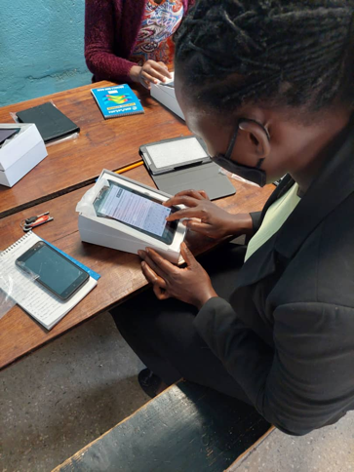
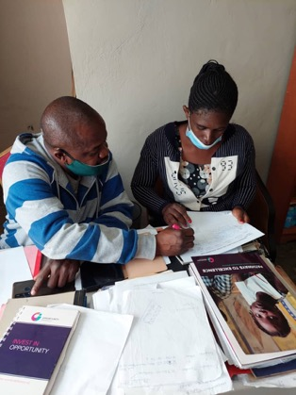
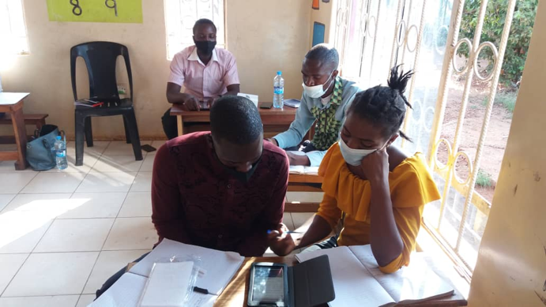
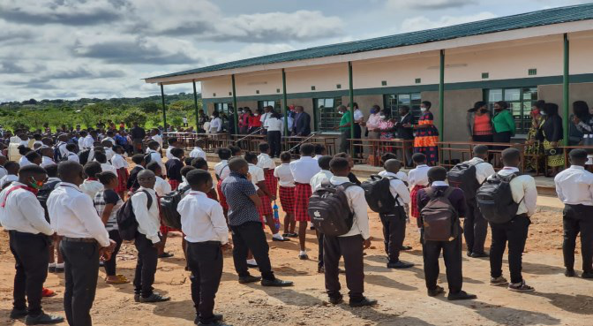
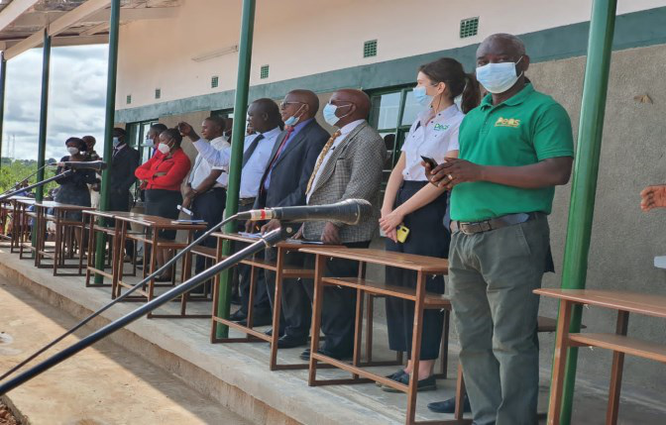
EduFinance
Quarterly Updates (Y3 Q2)
CATALYZE EduFinance teacher-mentor professional development and school leadership development workshops in Zambia
Photo credit: Opportunity International
Students and faculty during CATALYZE EduFinance partner Promoting Equity in African Schools’ Kafulu Musungu school opening ceremony.
Photo credit: Promoting Equity in African Schools

Slide 33
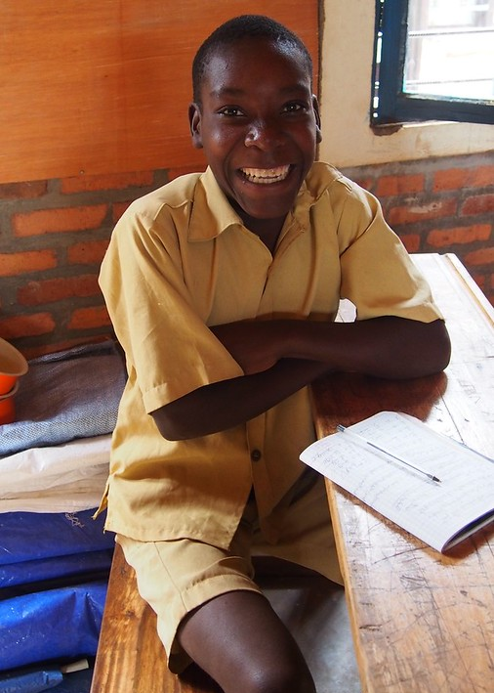
EduFinance
Quarterly Updates (Y3 Q2)
South Africa
Finalizing USD5.35M in commitments with a target close of December 2022. Mobilized financing (loans) with financial institution and EduQuality partner. 11 classroom kits have been financed through this mobilization. Onboarded new FI with extensive experience in education finance in South Africa. Carried out detailed research on the financial needs of low-fee Early Childhood Development (ECD) centers.
Rwanda
CATALYZE is officially registered in Rwanda and finalizing an MoU with the Rwandan government, expected to be signed early next quarter. With the signing of the MoU, active implementation is expected to commence. Researched the financial needs of ECD and Technical and Vocational Education and Training (TVET) centers. Most centers operate as community-needs based businesses whose owners have limited financial knowledge and business acumen and were initially financed through personal savings. Missed fee payments due to COVID-19 have led to challenges in paying salaries while aging infrastructure often prevents accreditation. The high cost of internet access and a lack of learning materials are also highlighted as challenges.
PHOTO CREDIT: GPE/SARAH BEECHING

Slide 34
EduFinance
Quarterly Updates (Y3 Q2)
Tanzania
Signed four technical assistance agreements with financial institution partners (Mwalimu, VisionFund, Absa, and Stanbic) to design an EduFinance product portfolio appropriate for the non-state education sector in Tanzania. Staff training was completed for two existing financial institution partners, Victoria and Equity, which launched a pilot of these products in March 2022.
Engaged with USAID/Tanzania to shift the focus of the activity from primary schools to pre-primary and TVET/secondary schools to better align with government priorities.
Democratic Republic of Congo (DRC)
Signed a technical assistance agreement with one new financial institution partner, Equity BCDC. One additional financial institution partner, Boabab, launched an EduFinance loan product pilot program while two more are expecting to pilot loan products next quarter. EduQuality school education improvement programming is ongoing in Kinshasa and Bukavu, with clusters of school leaders completing and submitting school development plans and recommending teachers to serve as teacher-mentors.
PHOTO CREDIT:COLIN J. MCMECHAN

Slide 35
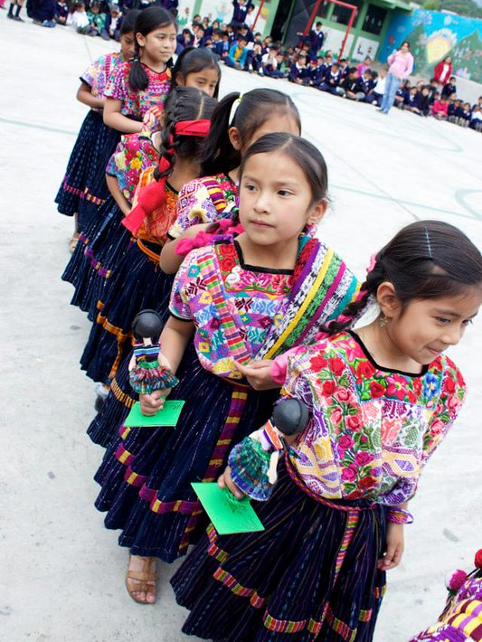
EduFinance
Quarterly Updates (Y3 Q2)
Latin America and Caribbean (LAC)
Kicked off activities in Dominican Republic, El Salvador, Guatemala, Haiti, and Paraguay.
In Dominican Republic and Guatemala, completed roadshows and signed technical assistance agreements with five partner financial institutions. EduFinance also has a technical assistance agreement with an existing financial institution partner in Haiti, with a financial institution roadshow expected to take place there later this year.
In El Salvador and Paraguay, CATALYZE EduFinance will support secondary and vocational education in rural schools and build each into a financially self-sustaining organization. EduFinance has engaged with potential donors and is identifying potential partner schools in both countries.
PHOTO CREDIT: DISCOVER CORPS

Slide 36
EduFinance
Quarterly Updates (Y3 Q2)
Kenya
CATALYZE EduFinance has revised and updated the market assessment that was conducted in 2021. The assessment included key insights from stakeholders from the Ministry of Education, schools, school associations, financial institutions, other education business service providers, and additional key partners. EduFinance is working with USAID/Kenya and the Kenyan Ministry of Education to determine dates to present findings from the assessment to a wider audience of key stakeholders.
Non-State Education Community of Practice (CoP)
Finalized a steering committee and prepared for the programming launch of the Education Finance Network (CoP) with an interactive webinar to discuss the question: How can non-state actors drive equity in education in low- and middle-income countries?
CREDIT: GPE/Kelley Lynch

Slide 37
EduFinance
Quarterly Updates (Y3 Q2)
Early Child Care and Education
EduFinance is conducting an assessment to prepare for future investment in early childhood care and education (ECCE) to increase quality of and access to early childhood care. This activity focuses on and promotes the “triple bottom line” of improved learning and development outcomes for children, increased women’s economic empowerment, and job creation—given that women are the key actors in the ECCE sector. EduFinance also developed an overview slide deck for USAID to use in promoting the activity with other donors.
Somalia
Conducting a market assessment of non-state education in Somalia to identify financing opportunities to increase access to quality education by engaging and the improving capacity of non-state schools through mobilizing private capital. The results of the market assessment will inform the feasibility and design of an EduFinance activity in Somalia.

Slide 38
EduFinance
Quarterly Updates (Y3 Q2)
Implementation Challenges | Solutions
Financial institution partners are hesitant to provide individual background information on some loan beneficiaries. If CATALYZE is unable to verify background information of loan beneficiaries to ensure compliance with Congressional guardrails (related in this case to level of income of beneficiaries), then we cannot deliver on or show clear adherence to PWS results for numerous countries. | EduFinance is working with implementing partners to improve methodologies for programming and data verification to capture relevant information. This includes potential incentives to financial institutions to provide the necessary information to ensure compliance with Congressional guardrails.
Host country governments are sometimes changing priorities around non-state education. In Tanzania, for example, the new government is concerned about support to primary non-state education—a current EduFinance focus there. If EduFinance cannot redesign the Activity to meet new priorities, the activity will face significant challenges. | EduFinance is actively engaging with new USAID/TZ staff in a co-design process to redesign the activity to meet their goals and priorities. This includes a probable shift in focus to pre-primary and secondary education (if this pivot happens, then it is expected that the original targets for schools and learners reached will be reduced).
There is often skepticism surrounding non-state education models and approaches. If the EduFinance team is unable to successfully convey the effectiveness of and rationale for non-state education models and blended-finance approaches, government, donor, and financial institution interest in this sector may wane. | EduFinance is creating a tailored Strategic Communications Plan, which in combination with the Community of Practice, will share evidence to address skepticism surrounding non-state education approaches and models.

Slide 39
WOMEN’S ECONOMIC EMPOWERMENT (WEE)
Activity summary: Mobilizing capital to create economic opportunities for women
Objectives
Empower women to succeed as entrepreneurs by mobilizing capital for W-SMEs via first-risk grants, the use of innovative financial technologies, and the provision of technical assistance
Enable women to thrive as capital allocators by enabling women-led and women-owned funds to raise capital, thereby overcoming barriers to women’s participation in the economy
Center women’s economic empowerment at the core of all CATALYZE activities to ensure that women equitably benefit from these, and are well-positioned to drive economic growth in their communities
Projected LOP budget of USD10 M, all of which is obligated
Capital mobilization target of USD30 M
Oct 2019 – Sep 2024
Global
Partners: BAC El Salvador (DFC investee), Sarona Asset Management, Lendahand crowdfunding platform

Slide 40
Women’s ECONOMIC Empowerment
Quarterly Updates (Y3 Q2)
Empowering women to succeed as entrepreneurs by mobilizing capital for W-SMEs
DFC Investee Partnership: BAC El Salvador
This quarter, WEE finished developing the product manual for a new financial product that BAC Propemi, a DFC investee in El Salvador, will be piloting.
The new financial product determines SMEs’ eligibility for loans by using point-of-sale metrics to determine their average cash flows.
This product benefits women-owned SMEs as they often lack sufficient assets that can serve as collateral to guarantee loans. With the POS-based lending product, BAC can use historical cash flows to determine grant financing to women as past cash flows are indicative of the SME’s future cash flows and thus ability to repay the loan.
The POS-based financial product will allow W-SMEs to obtain financial disbursements in less than 24 hours after verification of documents and contract signing, increasing timely access to financing, a barrier that W-SMEs often face.
The pilot of the new product will begin next quarter and expects to mobilize
USD3 million for W-SMEs
by September 2024.

Slide 41
Women’s ECONOMIC Empowerment
Quarterly Updates (Y3 Q2)
What Goes Into Making a New Financial Product a Success?
Pilot Recommendations
Start with what is easy
The new POS financial product that WEE developed for BAC El Salvador is the result of months of intensive consultations with BAC’s staff across various levels and departments, BAC’s current financial clients, and its prospective clients. Before developing the product manual, WEE conducted a data-driven gender diagnostic to determine BAC’s strengths and areas for potential improvement. It then developed a Gender Lens Financing Strategy in coordination with BAC, identifying areas in which BAC could strengthen its gender approach. Once the POS financial product was determined to be one of BAC’s key priorities, WEE met regularly with BAC and its team to determine how best to structure the new product technically and how to train BAC’s staff across departments to ensure its success.
WEE also worked with BAC to develop detailed recommendations for the product pilot. These recommendations are operational and give BAC guidance on what learning questions it should be asking and what areas it should be prepared to adjust or pivot towards based on findings during the pilot stage.
Most accesible clients
Clients that use digital channels
Women clients
Service centers
Extend beyond the comfort zone
More distant clients
Clients that do not use digital channels
Include men
Key cities in El Salvador
Reach the most challenging segments
Clients with outdated contact information
Clients that do not use digital channels
Throughout all of El Salvador

Slide 42
Women’s ECONOMIC Empowerment
Quarterly Updates (Y3 Q2)
Empowering women to succeed as entrepreneurs by mobilizing capital for W-SMEs, continued
Lendahand Grant – WEE issued a USD1.2 million grant to Lendahand, a crowdfunding platform, in July 2021. Using the funding, Lendahand will upgrade its platform to scale its capacity to mobilize investment from women and invest at least USD7.2 million in W-SMEs. This quarter, Lendahand focused on:
Implementation of new data architecture: With guidance of an external data expert, Lendahand began implementing its new data architecture to optimize the collection, sharing, and analysis of investee data and increase investor engagement.
Selection of eligible investees: Using the CATALYZE WEE definition of W-SMEs, Lendahand screened its portfolio of existing investees and potential new investees to determine which are eligible to be considered W-SMEs and can provide proper proof of disbursement. MiCredito, a current investee in Nicaragua, and Bailyk Finance, a prospective investee in Kyrgyzstan, are both eligible. Lendahand will continue to identify eligible investees in the coming quarters. Lendahand created a one-pager to promote awareness of the activity among potential investees.
Spotlight: Bailyk Finance, a women-owned microfinance institution in Kyrgyzstan, joined Lendahand as a new investee with the potential to raise USD5 million in two years on the crowdfunding platform. The money raised would be directly disbursed to W-SMEs.

Slide 43
Women’s ECONOMIC Empowerment
Quarterly Updates (Y3 Q2)
Empowering women to succeed as entrepreneurs by mobilizing capital for W-SMEs and Enabling women to thrive as capital allocators
Sarona Asset Management Grant
WEE issued a USD4.3 million grant to Sarona Asset Management in July 2021. Sarona will use the funding to raise and deploy a USD100 million fund (Sarona Global Growth Markets PE Fund 3 ILP or SGGM3) of which at least USD25 million in investment will target women-led funds and women-owned SMEs in emerging markets.
This quarter, Sarona focused on investor relations and pipeline development.
Investor relations: Sarona’s target market is US and Canadian High Net Worth and Registered Investment Advisors. It also works with family offices, foundations, and endowments. Sarona developed draft sales material including a teaser, pitch, due diligence questionnaire, and offering memorandum. Securing an investor takes three to 12 months on average.
Pipeline development: Sarona is actively building its pipeline of women-led funds within SGGM3. It will identify 15-20 women-led funds each year and invest in one to two per year, committing approximately USD25 million into these funds.
Sarona has raised USD10.5 M in soft commitments to the SGGM3 fund from 300+ individuals.
First close: September 2022 (USD50 million)
Final close: September 2023
(USD100 million)

Slide 44
Women’s economic empowerment
Quarterly Updates (Y3 Q2)
PHOTO CREDIT: CATALYZE PSD
Centering women’s empowerment at the core of all CATALYZE activities
This quarter, WEE:
Advised the EoG activity as it increased incentives for BASPs to encourage them to serve women-owned and women-led enterprises. WEE also helped assisted EoG in developing a pay for results (P4R) program designed to enable women-owned and women-led enterprises to increase market share via improved digital marketing.
Is advising the EduFinance Activity as it seeks to expand access by learners, families, and communities to high quality and affordable ECCE worldwide. The Activity will identify and pilot promising opportunities in up to three countries in the non-state early childhood care and education market, to attract private sector-based investment and expertise. There is considerable potential for the Early Childhood Care and Education Activity to foster and demonstrate the social, economic and development impact of the ‘triple bottom line’ in this space – namely, early childhood development and education; women’s economic empowerment, and a strong, sustainable investment model.
Met with EduFinance, PSD, F4R, EoG, and Peru Activity teams to develop a Gender Action Plan, which will allow for regular progress reviews and adjustments as needed.

Slide 45
Women’s ECONOMIC Empowerment
Quarterly Updates (Y3 Q2)
Implementation Challenges | Solutions
DFC Investee Partners: WEE approached numerous DFC investees as potential partners, but all have competing priorities and are overstretched with the TA and funding they are receiving from other multilateral financial entities and actors. For example, this quarter, the WEE activity lead reached out to three DFC financial institution investees operating in Ecuador, traveled to Quito, and underwent a co-creation workshop with Banco Pichincha to define an action plan for technical assistance. Ultimately, none of the DFC investees were able to commit to working with CATALYZE due to their own limited bandwidth and competing priorities. | WEE is working with USAID to identify other meaningful options to provide technical assistance not limited to DFC investees. One of the options is to collaborate with CATALYZE’s other buy-ins, such as F4R or EduFinance, to expand gender lens financing. Also, WEE is exploring partnerships with USAID El Salvador and the Private Sector Competitiveness program, implemented by Palladium in El Salvador, to offer a training to a group of DFC investee banks and individual technical assistance to each of the participating banks to review their credit policies and manuals to attune them towards serving more W-SMEs.

Slide 46
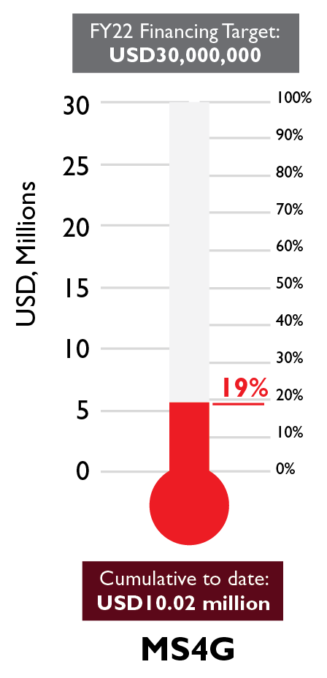
MS4G
Activity summary: To benefit the Ethiopian people, build community resilience, and strengthen rural-urban linkages, in the areas of food security and Water, Sanitation, and Hygiene (WASH).
Objectives
Expand Ethiopian enterprises (increased sales and revenues), resulting in more resilient and sustainable job creation and retention in urban and peri-urban areas
Better align workforce skills with and matched to the specific needs of private enterprises
Improve the business enabling environment to enhance private enterprise growth and resilience
Mobilize capital to unlock the potential of private capital to drive inclusive growth and more resilient businesses and employment
Advance an open, inclusive, and secure private sector-led digital economy
Increase USG’s capabilities to engage and close trade and investment deals through technical assistance to Prosper Africa Deal Team (PADT)
Projected LOP budget of
USD34.174 M, of which
USD15.8 M are obligated
Capital mobilization target of
USD275 M
October 2020 – Sep 2024
Ethiopia
Partners –SMEs, BASPs, Transaction Advisory Service Providers (TASPs), skills training and placement service providers, digital solutions providers, incubators, accelerators, International Non-Governmental Organizations (INGOs), consultants, associations

Slide 47
MS4G
Quarterly Updates (Y3 Q2)
MS4G Pivot to Food Security and WASH
Food Security and WASH-focused initiatives in development and procurement :
Strengthening Enterprise Ecosystem
Accelerator Program
BASP mechanism focused on SMEs working in food security and WASH
Improving skills and productivity
Finalize FON (Funding Opportunity Notice) to implement scalable and innovative solutions in Food Security and WASH
Business Enabling Environment
Conduct a WASH finance and policy study
Digital Economy
To onboard e-commerce sale and purchase of WASH products using the internet
Supporting MasterCard ag-financing rollout
In response to USAID/Ethiopia guidance and priorities, MS4G successfully pivoted its implementing strategy to place a significant focus on food security and WASH sectors aimed at:
Strengthening the agricultural value chain
Improving food security through facilitating market-based delivery of business development
Provision of financial advisory services
Increasing access to and usage of affordable, quality WASH products and services.
MS4G is in the process of designing initiatives and procurements focused on anchor firm-based enterprise development, accelerators, partnership with various organizations, capital mobilization, digital solutions, and skills and productivity in these priority sectors for roll-out over the next quarter.

Slide 48
Enterprise support disaggregation
MS4G
Quarterly Updates (Y3 Q2)
Strengthening Enterprises Ecosystem
To accelerate the capacity of SMEs in the food security and WASH sectors to grow, MS4G undertook the following activities this quarter:
Provided direct support for enterprise resilience through BASPs - As of March 31, 2022, MS4G is working with nine BASPs who signed P4R contracts to support 100 growth-oriented companies. The aim is to increase their sales and revenue by at least 10% within a year of receiving assistance. Of the 100 companies, 21 are in food security, 15 in the WASH sector, and 75% are women-owned. During this quarter, MS4G reviewed and approved four implementation progress reports, 96 enterprises diagnostic reports and implementation plans, and six BASPs’ monthly progress reports. MS4G also supported BASPs to ensure they met their first and second deliverables.
Designed an Accelerator Program to support growth-oriented, innovative, and scalable startup companies in WASH and food security sectors to advance their competitiveness in the market by improving their products, branding, and services.
MS4G held a bidders’ conference for the advertised Request for Proposal (RFP) on March 24, 2022, to partner with potential accelerators to support 100 companies (50 WASH and 50 Food Security). This activity will contribute to MS4G’s workforce development, enterprise growth, and digital economy components.
Supported SMEs working in food security (agriculture value chain) – MS4G developed a concept note and an RFP to support 150 SMEs (cooperatives, unions, farm services, and aggregators) working in the food security value chain. The initiative will use the BASPs’ P4R mechanism to support SMEs through financial and digital literacy and business management to enhance credit worthiness and improve sales and revenue.
In partnership with the Alliance for Coffee Excellence, MS4G supports the participation of Ethiopian smallholder farming enterprises in the prestigious Cup of Excellence (CoE) global competition through the provision of financial support and technical assistance on a pay-for-rewards basis. A concept note was developed to provide technical support in business development, workforce development, and the digital economy.

Slide 49
e-Job Placement Platform (JPP) – To strengthen e-Job placement platforms, MS4G announced an RFP and held a bidder’s conference to contract a tech company in January. The company will use the recommendations from an assessment MS4G conducted to technologically enhance JPPs, including using artificial intelligence for better job matching.
The Youth Advisory Board visited two MS4G contracted skills training and placement centers to provide insights on how to improve services to meet specific employment needs of the youth.
Partner with professional/business associations to increase youth and women employment
To enhance graduate students’ employability, the Association of Chartered Certified Accountants provided practical knowledge in accounting and finance for 327(209F) graduate students in Addis Ababa this quarter.
MS4G is partnering with I-Capital Africa Institute to establish an Association for Talent Development for private WFD actors. In this quarter, the Association was legally registered, and registration of members, operationalization and promotion activities are underway.
Co-invest and support industry-led WFD and job placement
To promote job prospects in Industrial Parks, MS4G is finalizing an MoU to scale Hawassa Industrial Park’s Sourcing Center, Grading Center, and Welcoming center to other implementing partners.
MS4G
Quarterly Updates (Y3 Q2)
Improving skills and productivity - Workforce Development (WFD)
MS4G uses P4R awards, partnerships, and networking to facilitate skills and job creation, enhance e-Job placement platforms, and partner with incubators and accelerators to support early-stage SMEs with the potential to create jobs. MS4G collaborates with educational and technical institutions, anchor firms, youth-oriented organizations, and employers to equip youth and women with the skills required to work in the private sector.
Improve women’s and youth skills and productivity – MS4G is working with six partners to train and place 11,000 youth and women in full-time equivalent jobs through P4R awards. This quarter, MS4G trained 2,182 job seekers.
A Funding Opportunity Notice RFP for youth job creation in food security and WASH sectors was announced in March, with the aim to create 3,000 jobs for youth and women in Addis Ababa and secondary cities.
MS4G Assistance Disaggregated by Sex, Age, and Region

Slide 50
MS4G
Quarterly Updates (Y3 Q2)
Business Enabling Environment Improved
To increase the resilience and sustainability of Ethiopian enterprises in the WASH and food security sectors, MS4G builds the capacity of institutions to create a supportive business enabling environment in finance, investment, and the digital economy. In addition, MS4G works to builds an understanding of existing policy gaps and their implications to have an effective and inclusive voice when engaging with policymakers to achieve change.
To improve the enabling environment for a sustainable and reliable supply of inputs, MS4G prepared a policy note that advocates for changes in the mode of payment and duty- and tax-free input import permits in support of African Improved Foods (producer of supplements).
MS4G drafted a policy note on the draft investment incentive regulation to better understand the implication of the regulation on enterprises, especially on food security and WASH enterprises.
Towards creating an enabling environment in the digital ecosystem relevant for enterprises’ growth and employment for the youth and women in the food security and WASH sector, MS4G drafted an Article of Association for the establishment of the ICT Park Investors Association and provided legalization technical assistance.
MS4G finalized an MoU that frames the collaborative partnership between MS4G and the Ethiopian Chamber of Commerce and Sectoral Associations in support of its members in the food security and WASH sectors.

Slide 51
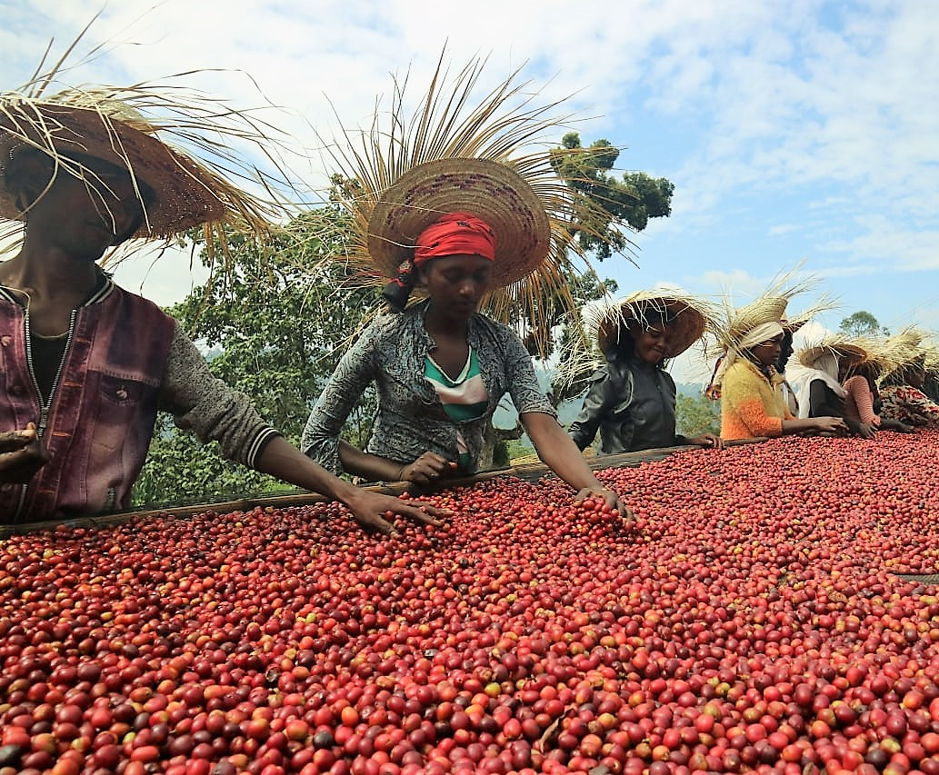
MS4G
Quarterly Updates (Y3 Q2)
Access to Finance
Build and Support Investment Portfolio - The MS4G in-house investment team grew its pipeline of firms supported by nine new private enterprises pursuing investments totaling close to USD16.3 million. The new pipeline companies represent 60% food security/agriculture and 40% WASH.
Debt - MS4G mobilized USD2,093,620 in debt financing from local banks to:
BunAroma Coffee - USD400,962.31(January 2022)
Etiopica Coffee - USD96,606.2 (March 2022)
Dambi Udoo agro-industry - USD1,596,051.73 (January-March 2022)
Equity – MS4G hired Transaction Advisor Service Provider Lucy Partners to close a USD2,626,183 deal for Project Tower to produce and supply towers for Safaricom and Ethio-Telecom. Of the USD2.6 million deal, USD957,912 has been mobilized to date.
Blended Finance – MS4G completed the design of its blended finance mechanism to incentivize FIs to increase SME access to finance. A Request for Application (RFA) was prepared. The RFA provides incentives to commercial banks to extend credit to food security and WASH SMEs on a pay-for-result basis.
Women working at Dambi Uddo coffee farm. Dambi Uddo Agro industry PLC grows coffee for export. It has one of the best coffee varieties in Ethiopia that fetched the third highest price (per pound) in the 2021 harvest season. MS4G provided the company advisory and transaction facilitation support to secure USD1.5 million in debt financing from three local banks. (Awash Bank, Bank of Abyssinia and Oromia Bank.). Photo: CATALYZE

Slide 52
MS4G
Quarterly Updates (Y3 Q2)
Trade
MS4G works to enhance USG capabilities to catalyze two-way trade and investments.
PADT Support
MS4G provides secretariat and advisory support to the Prosper Africa Deal Team to increase USG’s capabilities to engage with and facilitate catalytic investment and trade opportunities. In the last quarter, MS4G:
Conducted a survey of the PADT Team to evaluate MS4G support, resulting in 84% satisfaction rate
Organized presentation of Northern Ethiopia Private Sector assessment
Analyzed new regulations in the banking sector
Provided an overview of the Ethiopian Investment Holdings.
Kidist Mulugeta, Country Coordinator, Cup of Excellence explaining the competitive process that makes CoE exceptional. Photo credit: Selome Kebede/USAID CATALYZE.

Slide 53
MS4G
Quarterly Updates (Y3 Q2)
Private Sector-Led Digital Economy Advanced
MS4G accelerates the use of digital solutions and services to improve the efficiency of food security and WASH oriented enterprises. MS4G’s market systems approach includes fostering investment in digital enterprises and services/solutions providers, expanding the adoption of digital solutions, and addressing policy impediments to digital transformation at the enterprise and sector level.
In this quarter, the team is collaborating with workforce development, technologically enhanced e-Job placement platforms to build better job matching services, supporting food security and WASH value chain startup companies in utilizing digital platforms to advance their business, and facilitating digitizing 150 WASH and food security SMEs.
Cloud Computing Study
MS4G conducted the first-ever Cloud Computing Business Investment study to provide an overview of the industry's existing landscape, supply of service providers, and the degree of market demand. MS4G commissioned the study in support of RedFox Solutions Group’s planned investment in the sector. Following feedback from the MS4G tech team and RedFox, the study was finalized at the end of March.
Digitization of Agriculture Value Chain Study
MS4G is working in partnership with MasterCard to support the introduction of an agricultural supply chain financing and payment system in Ethiopia. MS4G is in the process of seeking qualified consultants to undertake a feasibility study on the implementation of the MasterCard system in Ethiopia. MasterCard has deployed the system in four countries in Africa. MS4G is supporting MasterCard’s negotiations with the commercial Banks in Ethiopia, the Ethiopian Postal Service, and Telebirr for integration into the MasterCard supply chain system.
On January 11, 2022, MS4G signed an agreement with MasterCard International Incorporated to enhance the digitalization of the agricultural value chain. MS4G issued an RFP to analyze the value chain actors, types of payments they work with, and the likelihood of adopting digital platforms for conducting transactions. The evaluation process is completed, and MS4G is waiting for the selection of a winner.

Slide 54
MS4G
Quarterly Updates (Y3 Q2)
Implementation Challenges | Solutions
The lack of capacity of service providers, such as weak monitoring and evaluation skills, impacts their ability to deliver on time. | Recognizing that service providers have different levels of capacity required to succeed, MS4G is designing a system where partners can learn and interact with each other. This includes providing training such as in monitoring and evaluation tools, organizing discussion forums (WFD stakeholders workshop), hosting regular meetings to share experiences and learnings, and continuous follow-up.
Due to the recent conflict in some parts of the country, geopolitical challenges slowed down partnerships with governmental organizations such as Federal Job Creation Commission and buyers such as TCP. | MS4G is placing a greater focus on partnering with private sector associations and other similar market actors to bring sustainable and systematic changes in our program areas and putting partnerships with Government of Ethiopia affiliated organizations on hold until the political dynamics improve.
High collateral requirements, limited liquidity, and limited lending products are major barriers to SMEs' access to finance. In allocating finance for private enterprises, SMEs often receive low priority. Lenders see SMEs as riskier borrowers who lack the collateral, assets, and financial acumen of other borrowers to whom they can lend their limited capital. | MS4G is issuing a Request for Application for the MS4G blended finance activity on a P4R basis to incentivize financial institutions to provide credit to these underserved segments. Through this facility MS4G will engage FIs to expand access to finance for SMEs by providing cash incentives (1-3% success fee of disbursement value) to commercial banks to extend credit to SMEs.
Conflict and political instability, a series of National Bank of Ethiopia (NBE’s) directives on lending freeze, and shortage of forex highly impacted investment interest and investors are more cautious and reluctant to make final decisions. In addition, a limited number of TASPs advising on smaller deals slowed down the capital mobilization process. | MS4G adapted activities to the changing regulatory space, including designing de-risking mechanisms, leveraging guarantees (DFC and other), supporting bankable transactions, looking for local equity players to invest in companies, customizing facilitation services in response to changing regulations, and utilizing personal networks to move deals forward. To maximize TASP contribution, MS4G is designing a mechanism to expand its TASP program.

Slide 55
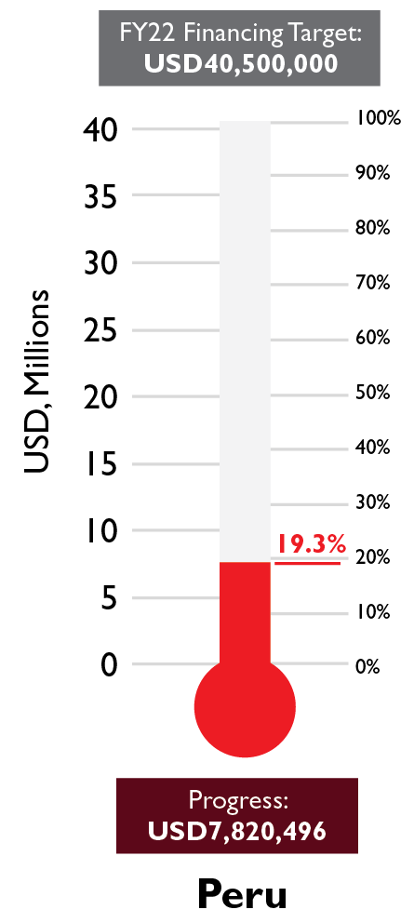
PERU
Activity summary: Catalyze investment and access to finance in the Peruvian Amazonia
Projected LOP budget of USD15 M, of which USD5 M is obligated
Capital mobilization target of USD106 M
May 2020 – Dec 2023
Amazonia region of Peru
Objectives
Structure and facilitate financing for large-scale projects, business models, and private investment opportunities in the Peruvian Amazonia that serve as long-term drivers of economic growth in the region
Increase access to and utilization of finance by SMEs and producer associations in the Peruvian Amazonia by providing incentives and technical assistance to financial institutions and BASPs to facilitate financing
Develop digital information systems to support greater supply chain transparency for value chain competitiveness and access to finance among upstream actors
Additional USD2 million generated during quarter but in process of verification would bring total against target to 26%

Slide 56
PERU
Quarterly Updates (Y3 Q2)
Facilitating access to finance
54 companies are receiving technical assistance from CATALYZE Peru through BASPs and specialized consultants, in eight different regions of the Amazonia.
CATALYZE Peru has engaged 18 BASPs that are working with 64 SMEs to structure 67 loans valued at USD42.8 million.
Two of the 18 BASPs (11%) are led by women, and they are the top performers.
CATALYZE Peru closed six deals towards the end of quarter valued at USD1.3 million for a total of 17 deals valued at USD6.7 million. This USD1.3 million is not yet reported under total private capital mobilized as it is pending internal verification from the CATALYZE M&E team.
CATALYZE Peru has 16 signed MoUs with anchor firms that if successfully implemented would lead to USD66.3 million in private capital mobilized.
One example of these MoUs is with Madre de Dios, which includes six companies seeking to invest in sustainable green businesses over 102,000 hectares. Through this MoU, these companies intend to generate employment for 7,000 local inhabitants and to mobilize USD23 million over the life of project.
Spotlight on CATALYZE Peru BASP Agreements
18 BASPs | 8 Regions
USD42.8 million in process
Region | Potential loans (USD million)
San Martin | 10.2
Loreto | 10.1
Junín | 7.4
Ucayali | 4.0
Pasco | 3.0
Huánuco | 2.0
Madre de Dios | 3.6
Amazonas | 2.5
Total | 42.8

Slide 57
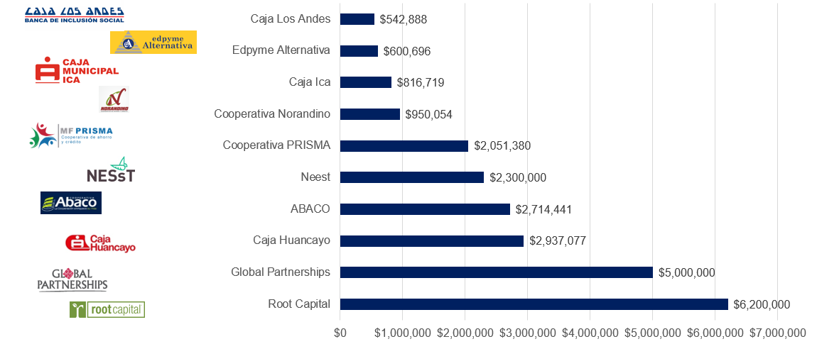
PERU
Quarterly Updates (Y3 Q2)
Summary of CATALYZE Peru FI partners and financing commitments
Increase access to and utilization of finance by SMEs and producer associations
Signed P4R grant agreements with 10 FIs (7 local, 3 international) who have committed to mobilize USD24.1 million.
To date, these FIs have reported USD5 million in financing in 10 regions, benefiting 574 MSMEs (58% women).
The average financing amount released from financial intermediaries is approximately USD2,000, and sectors financed include commerce, agriculture, and transportation services.
5 new FIs have applied to CATALYZE Peru's P4R program.
Providing support to DFCs Loan Portfolio Guarantee (LPG) due diligence process with 2 FIs. Potential LPG size is USD20 million.
10 agreements with local and international FIs
USD24.1 million in financing commitments
*Total financing pending internal verification is USD4 million benefiting nearly 2,000 MSMEs.

Slide 58
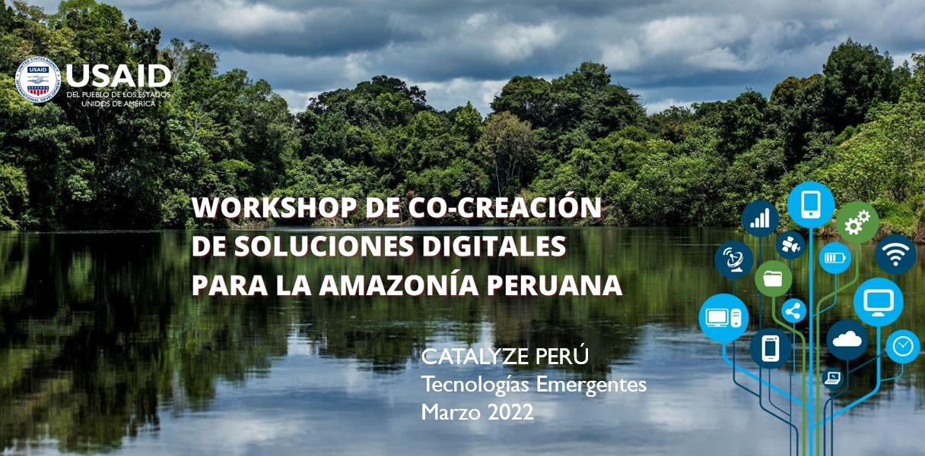
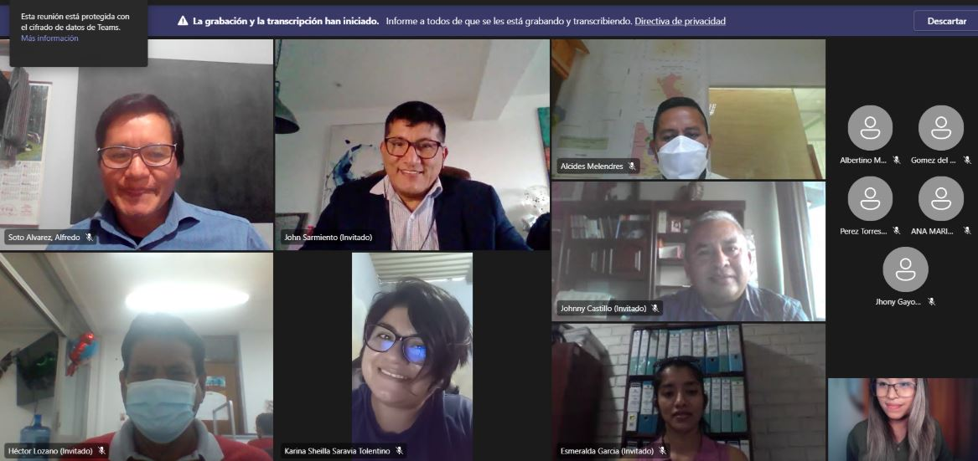
PERU
Quarterly Updates (Y3 Q2)
Developing Digital Information Systems to Support Greater Supply Chain Transparency
Conducted a mapping study of data sources and systems that exist in the Amazonia region. Participants included representatives from FIs, agriculture, agro-industrial, and technology companies.
On March 9, 2022, hosted a workshop titled "Mapping of data and digital solutions for the Peruvian Amazon” to generate a dialogue between digital service providers and actors in the value chain in order to gather key information for the study. Participants included representatives from Ahorro Prisma COOP, Caja Municipal de Ica, Agroindustrial CENFROCAFE COOP, and 4TOLD Fintech.
CATALYZE Peru continues working with Villa Andina and one financial institution to design and implement a digital data collection system that would provide transparency into the company’s operations and products. Agricultural suppliers of Villa Andina will benefit from this digital data system by enabling use of data to obtain loans at lower interest rates and receive premium payments on crops and organic certificates.

Slide 59
PERU
Quarterly Updates (Y3 Q2)
Implementation Challenges | Solutions
Financial institution interest: Commercial banks to date have shown low interest in participating in the financial incentive program. CATALYZE Peru initially projected that banks would contribute to 25% of its financial mobilization targets. Without expected participation rates, hitting this expected capital mobilization target may be at risk. | Issued a rolling RFA to allow a wider range of FIs to learn about the program and have adequate time to apply. Municipal Cajas and international financial intermediaries have expressed interest in extending financing in the Peruvian Amazonia. Intensified efforts to generate interest in the FI P4R program, including a large bidders conference, a webinar promoting DFC and CATALYZE, and region-focused marketing efforts to gain support from commercial bank regional branches. Strengthened the offer of advisory services to commercial banks as an additional incentive to the P4R grant. Increased efforts to partner with international FIs given their larger investment size focus; average loan with existing partners is USD700,000.
Palm oil engagement: CATALYZE Peru has executed three MoUs with palm oil companies. At the request of USAID, these have been placed on hold pending their review in alignment with Congressional requirements. | Upon completing an internal analysis, USAID will inform us on whether we can proceed with supporting financing to the palm oil sector. In the interim, the team is evaluating opportunities with more anchor firms to strengthen pipeline under MoUs. With a strong pipeline of anchor partners in place, the team is shifting focus to managing implementation of existing MoUs.
Digital traceability: CATALYZE Peru and Villa Andina re-evaluated our initial strategy to procure a traceability system for this partner to find a more sustainable solution to support this anchor firm meet its digital data and transparency objectives. | Underwent a co-creation process with Villa Andina to determine other options for co-investment responsibilities. Villa Andina will purchase the software license for the traceability system according to its needs and CATALYZE Peru will provide TA to implement the digital system.

Slide 60
PRIVATE SECTOR DEVELOPMENT (PSD) - SRI LANKA
Accelerating inclusive growth, especially for women, by increasing competitiveness and funding to MSMEs
Objectives
Cross-cutting theme: Increased women’s labor force participation, access to finance, and women’s entrepreneurship
Improved capacity and competitiveness of MSMEs. PSD provides direct assistance to MSMEs, expands business advisory services to advise MSMEs better, and increases opportunities for women in the workforce and female business owners.
Improve access and availability of financing for MSMEs. PSD is developing partnerships with financial institutions to support capacity building and encourage the development of innovative financing solutions, incentivize increased lending to MSMEs in target sectors, expand innovative blended finance, and support USAID Development Finance Corporation activities in Sri Lanka.
Increase SME resilience to the economic impacts of COVID-19. PSD is deploying $1.7 million in grants to help MSMEs withstand the impact of and recover from the COVID-19 pandemic. Adaptation grants are designed to spur innovation and adaptation to the impact of COVID-19, while emergency relief grants provide immediate economic support to MSMEs severely affected by COVID-19 and at risk of going out of business before the pandemic recedes.
Projected LOP budget of USD12 M, of which USD7.8 M is obligated
Capital mobilization target of USD39 M
May 2020 – Sep 2024
Sri Lanka
Partners: Financial Institutions, Business Advisory Service Providers, Lead Firms, and Business Associations

Slide 61
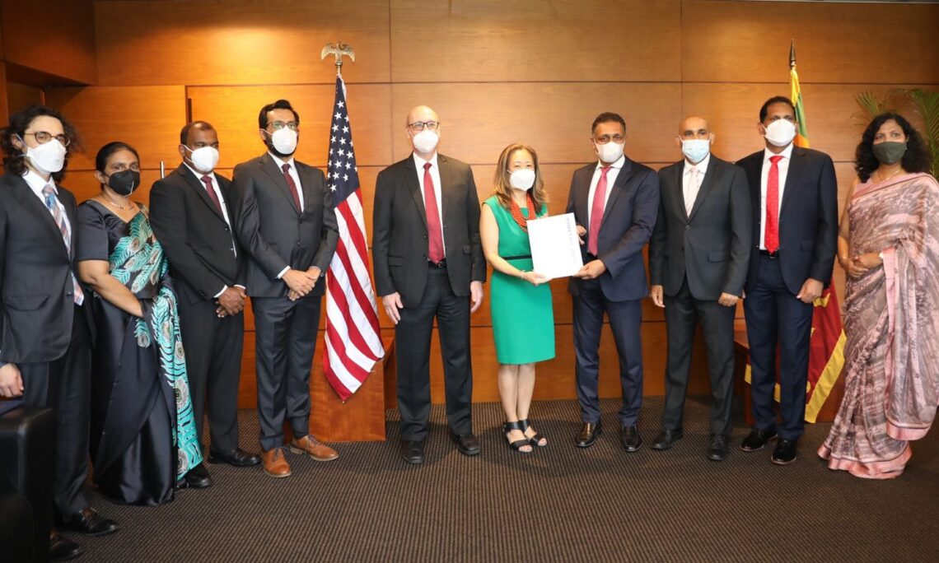
PRIVATE SECTOR DEVELOPMENT
Quarterly Updates (Y3 Q2)
MSME Competitiveness
PSD launched a Request for Proposals for BASPs for services and technologies for MSMEs (aiming to reach 200-300 MSMEs through 8-10 BASPs).
Developed a Statement of Work on promoting market access and market linkages for MSMEs via Berendina’s EKADE digital platform (200 MSMEs to be supported).
MSME Financing
MoUs signed with two additional Financial Institutions, (four in total) agreeing to leverage USD5-7M in new debt financing for MSMEs.
Second RFA published to place two additional FIs on grants under contract.
Agreed on a partnership with PwC to develop a Scoring Model for FIs in the ICT sector to expand financing to ICT companies through four financial institutions.
PSD signed an MoU with DFCC bank on February 28, 2022. This partnership will enhance financial products and services for MSMEs, strengthen digital penetration and market linkages for MSMEs, and increase access to commercial lending to MSMEs, especially to enterprises located outside of Western Province and those led by women. PSD is now developing a plan to begin implementing this partnership. (Micah Globerson - Deputy Economic Growth Office Director, USAID Sri Lanka and Maldives, Delrene Seneviratne - Deputy Field Team Lead, Catalyze PSD Sri Lanka, Jude Fernando - Director Financial Facilitation, CATALYZE PSD. Juan Forero - Activity Team Lead, CATALYZE PSD, Reed Aeschliman - Mission Director, USAID Sri Lanka and Maldives, Julie Chung - US Ambassador to Sri Lanka, Thimal Perera - Chief Executive Officer and Director, DFCC Bank, Aasiri Iddamalgoda - Senior Vice President Retail Banking and SME, DFCC Bank, Anton Arumugam - Vice President, Offshore Banking Trade and Institutional Business Development, DFCC Bank, Samanthri Kariyawasam - Vice President, General Legal, DFCC Bank)

Slide 62
PRIVATE SECTOR DEVELOPMENT
Quarterly Updates (Y3 Q2)
SME Resilience
Through three procurements mechanisms:
Funding Opportunity Notice for Innovative Grants
RFA for MSMEs for relief grants
RFA for Tourism for relief grants
PSD successfully designed 52 Covid-19 grants, valued at USD1,670,999 as of March 31, 2022.
PHOTO: Ishani Jayamaha

Slide 63
PRIVATE SECTOR DEVELOPMENT
Quarterly Updates (Y3 Q2)
Implementation Challenges | Solutions
Economic crisis: Sri Lanka’s currency (LKR) is rapidly depreciating against the USD (by almost 50% in this quarter and continues to slide). This will affect scale of lending and investment from financial institutions and value of results achieved targets in USD (increase in sales and capital mobilized). | PSD will link key payments to USD, adjust the number of stakeholders, grantees, and milestones, and report on progress made in both LKR & USD.
Small grants management: PSD received and processed an overwhelming number of applications - more than 740 – to select 52 small Covid-19 Relief grants facility. | PSD’s more recent procurements included a more targeted approach while encouraging competition among applicants/offerors.
Lower lending to key sectors: FIs have limited understanding of how MSMEs operate in PSD’s target sectors (tourism, ICT, and commercial care) and low capacity to accurately assess their credit worthiness. | PSD will increase FIs’ sectoral knowledge and create/improve current scoring systems for selected institutions. PSD is also facilitating a pipeline of bankable SMEs (e.g., grantees, referrals, other USAID programs) to accelerate lending to underserved sectors.

Slide 64
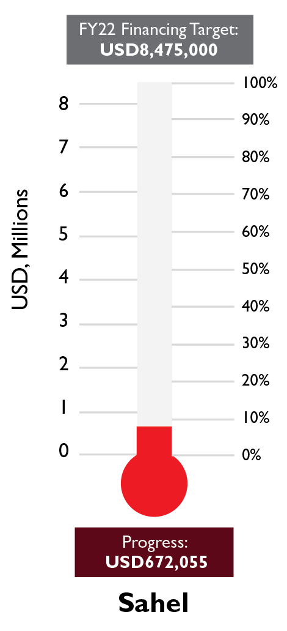
FINANCE FOR RESILIENCE (F4R) - SAHEL
Activity summary: Increase financing to support capital investment in the agricultural sector and in youth-led enterprises
Projected LOP budget of USD10.7 M, of which
USD6 M are obligated
Capital mobilization target of up to USD34 M
Aug 2020 – Sep 2024
Burkina Faso and Niger
Implementing partners: ICDE (Burkina Faso) and SINERGI SA (Niger). Collaborators: Project Yalwa, Project Yidgiri, Bridge Youth Connect, WATIH, DFC, USADF, Sahel Collaboration and Communication Activity
Objectives
Expand access to finance for enterprises and producers in targeted sectors and groups - F4R’s targeted groups are agriculture value chain actors and youth entrepreneurs. Agriculture value chain actors refer to farmers and other primary producers, such as input providers, processors, etc. In line with USAID’s RISE II intervention, F4R focuses on three value chains: cowpea, small ruminants, and poultry.
Develop a network and build the capacity of local finance facilitators (FFs). This refers to individuals or firms who work with stakeholders in target sectors and who help facilitate securing of financing from financial institutions. FFs do not have any financial stake in the enterprise or the investment.
Provide financial institutions (FIs) incentives and market linkages to increase access to finance. Low planning and coordination capacity in Burkina Faso and Niger hinder the efficacy of expanding access to finance, largely due to limited financial, logistical, and human resources.
Notes:
No Updates needed on this slide

Slide 65
FINANCE FOR RESILIENCE
Quarterly Updates (Y3 Q2)
Expand access to finance for enterprises and producers
In Burkina Faso, F4R and its partners have mobilized USD1,875,034 for the benefit of 110 enterprises. This is 51% of the Y2 performance target.
As of March 30, total eligible pipeline of financing deals in Burkina Faso is USD5,269,145 and USD5,063,725 in Niger.
Develop network and build the capacity of local financial facilitators
F4R continued to provide technical assistance and monitoring of the performance of the pipeline for FFs under contract. Assistance was provided through workshops, meetings, advisory support in client outreach, and relationship management with FIs.
Currently developing training program for emerging FFs with tools for supporting clients in our target value chains.
Continuously seeking synergies with USAID's other RISE II partners. The team collaborated with Yidgiri, Yalwa, Youth Connect, TEV, and SCC to reach target groups for capital mobilization.
F4R continues searching for additional collaboration with non-RISE II Partners to optimize the activity’s capital mobilization’s targets and investment. In Niger, Orabank has a credit guarantee with DFC, which aligns with our target groups. We are working to link our FFs with Orabank. In both Burkina Faso and Niger, we partner with banks currently outside our FI network but interested in working with our partner FFs.
CREDIT: ILRI/Apollo Habtamuj, COURTESY OF FLICKR CREATIVE COMMONS
Notes:


Slide 66
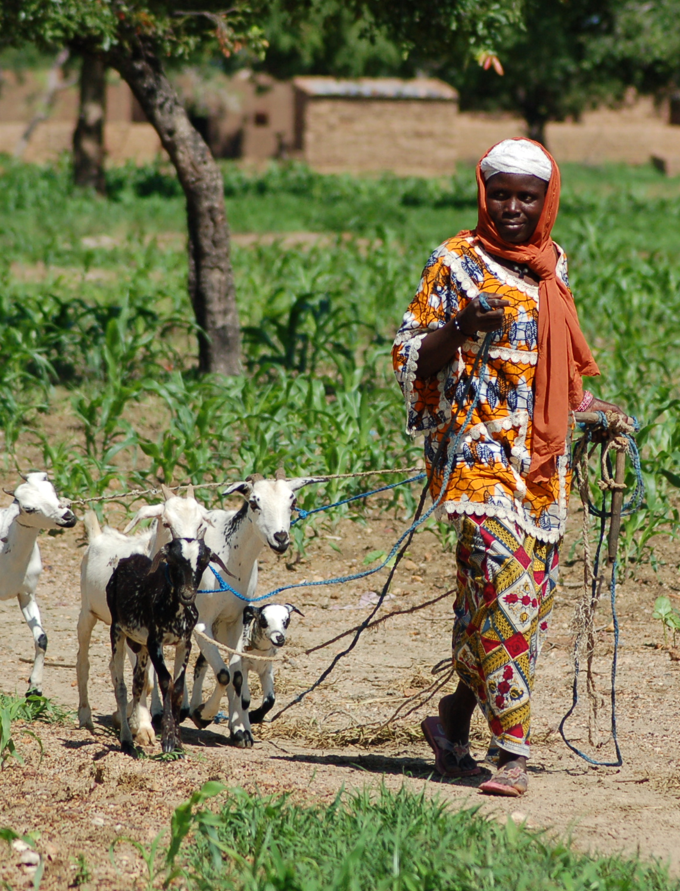
FINANCE FOR RESILIENCE
Quarterly Updates (Y3 Q2)
Provide FIs with incentives and market linkages to increase access to finance
Reinforced technical assistance and monitoring of the performance of FIs under contract with CATALYZE. Meetings were held with four FIs in Burkina Faso to appropriate the CATALYZE implementation scheme, improve collaboration with FFs, and provide advisory support in identifying and accompanying eligible clients to be financed under CATALYZE.
In Niger, the recruitment of partner FIs was finalized. An orientation session was conducted, and first pipeline reports were submitted in March. Additionally, the activity received a new offeror for the extension of the FI network from ACEP and UMC, which are currently under evaluation. Finally, the activity met with ORABANK regarding the guarantee and initiated exchanges on the possibility of the banks’ enrollment in the partner FI network.
CREDIT: TREEAID, COURTESY OF FLICKR CREATIVE COMMONS

Slide 67
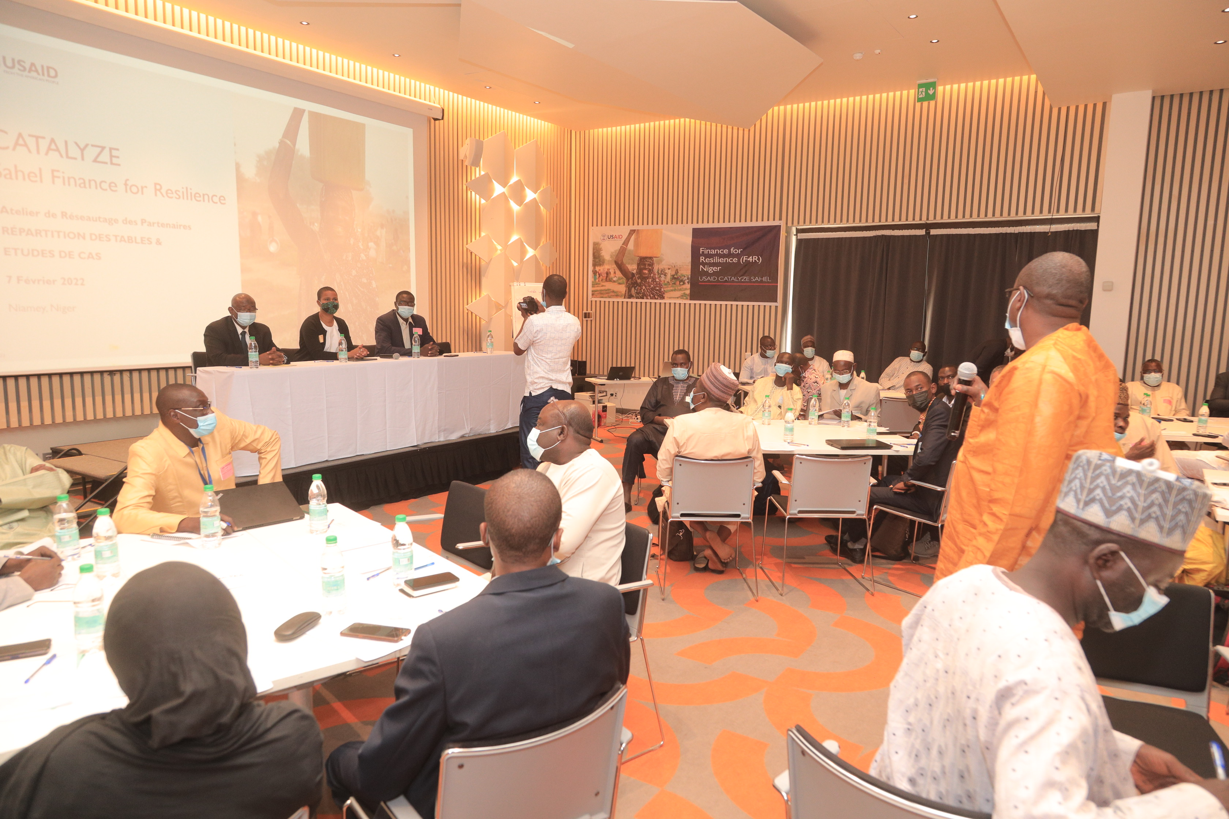
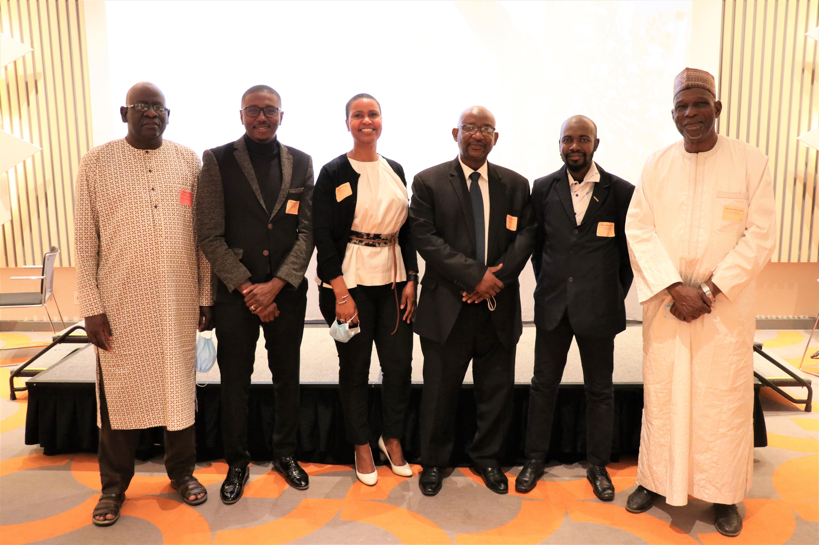
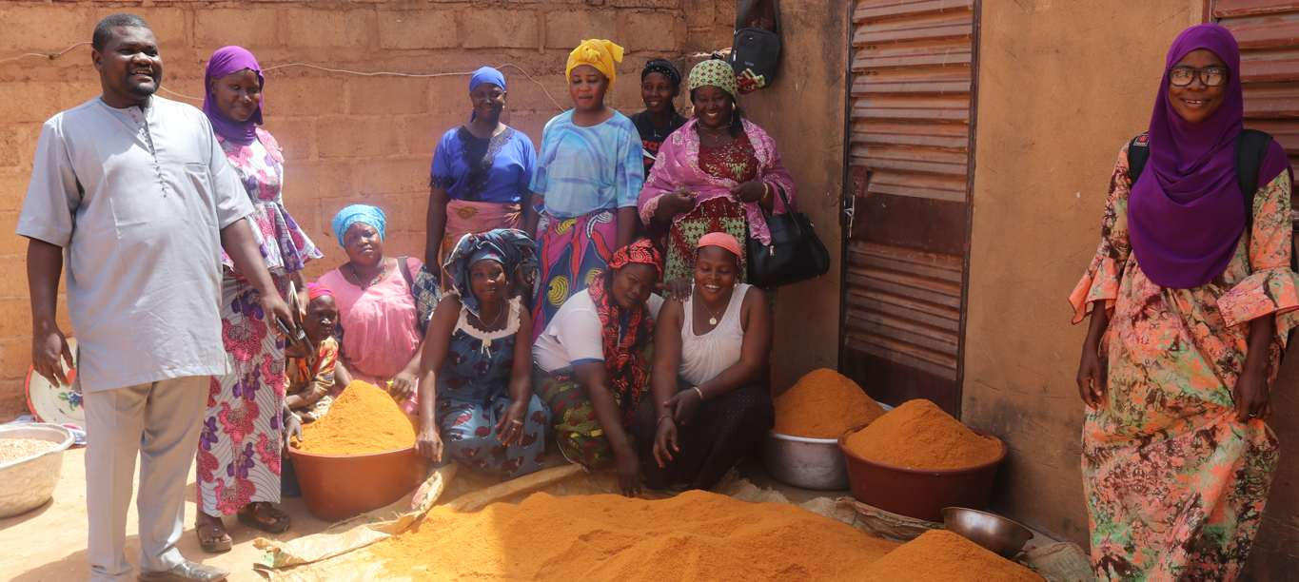
FINANCE FOR RESILIENCE
Quarterly Updates (Y3 Q2)
Feb 7, 2022 – Niger: networking between FFs, FIs, and RISE II Partners. Photo credit: CATALYZE F4R.
Members of the Wend Konta’s women association with representatives of Caisse Baitoul Maal, a Financial Institution, during a site visit in Kaya, Burkina Faso. (From left to right: Mamadou Boulo, a representative from Caisse Baitoul Maal and the female members of the association) Photo credit: CATALYZE F4R
Feb 11, 2022 – Niger : Journal article « Cahier de resilience », Photo credit: CATALYZE F4R

Slide 68
FINANCE FOR RESILIENCE
Quarterly Updates (Y3 Q2)
Challenges | Solutions
Complexity of documentation and verification requirements. Targeting incentives so specifically, while also leaving some latitude for flexibility, creates significant reporting and documentation requirements for our partners. The emerging FFs and smaller FIs are not accustomed to such reporting and do not have systems in place to facilitate it. It also makes the tendering process quite complicated for the kinds of entities most likely to reach our target groups. | F4R teams are providing individual follow-ups to help applicants mitigate challenges in applying and managing pay-for-results programming. F4R is creating video tutorials and sharing these with project partners to explain the key steps of the different procedures.
The outbreak of avian flu in December 2021 drastically reduced financing of this value chain by financial institutions. This is the third outbreak after previous outbreaks in 2006 and 2015. For the third time, the entire poultry value chain was negatively impacted by this disease. | Continue collaborating with Yidgiri, which facilitates trainings on health measures to be adopted to face the disease. These trainings will contribute to the mastery of good practices and risk reduction to facilitate access to financing for credit applicants in this value chain.
A difficult security environment. The deteriorating security situation in some parts of Burkina Faso has led to the displacement of more people, a further decline in economic activities, and the closure of branches of financial institutions in these regions. This situation increases challenges in loan monitoring and debt collection. | Technical assistance will be provided to Financial Facilitators to equip them with tools to support SMEs within the current context. Also, P4R will analyze the possibility of providing technical assistance to FIs in their digitization process to serve these areas. Collaboration with World Council of Credit Unions could be very helpful in this regard.
A delay in collaboration with the USAID Bridge Youth Connect (BYC) project. The implementation of the BYC project in Burkina seems to have been delayed. BYC's actions in identifying and training young people are essential prerequisites to allow financial institutions to grant them financing. As BYC is a very important partner for youth access to credit, this delay in the implementation of activities limits CATALYZE's actions in this area. | Continue to interact with the BYC team to further identify and implement joint activities in facilitating access to finance for youth.

Slide 69
Engines of Growth (EoG) - Western Balkans
Activity summary – Increase small- and medium-sized enterprise (SME) access to and use of finance to drive enterprise growth
Objectives
This activity will engage market actors and other stakeholders to identify key constraints and opportunities and develop one or more activities to minimize the access to finance constraint. EoG will focus on the following primary objectives:
Projected LOP budget of USD8.8 M with potential for additional mission activities. Capital mobilization target of up to USD100 M
October 2020 – Sep 2024
Albania, Bosnia and Herzegovina, Kosovo, Montenegro, North Macedonia, and Serbia
Mobilize capital and/or restructure debt to otherwise vulnerable SMEs which have been adversely impacted by COVID-19 in order to sustain them, retain/rehire workers, and preserve capacity for future growth
Facilitate additional alternative financing to high-potential SMEs in the Western Balkans to enhance their growth, productivity, and job creation
Compile relevant available data on the transformative effects of the COVID-19 crisis and its impact (and anticipated impact) on health, real economy (good and services), financial markets, and government policy in the Western Balkans.
EOG mobilized $8,605,728 in Q2 for a total of $18,758,909 year to date

Slide 70
ENGINES OF GROWTH
Quarterly Updates (Y3 Q2)
Mobilize capital and/or restructure debt to otherwise vulnerable SMEs
EoG subcontracted BASPs in Albania, Bosnia & Herzegovina, Kosovo, North Macedonia, and Serbia using a P4R incentive structure to mobilize capital for SMEs that have been impacted by the COVID-19 economic downturn. To date, USD29.1 million in capital was deployed to 50 firms of which USD3.8 million went to W-SMEs.*
Forty-eight BASPs provide their services throughout the Western Balkan region, of which 15 are women BASPs.
Four loans have been restructured as companies struggle to pay back original loans that were taken out pre-COVID. BASPs are reporting that financial hardships are expected to continue for Western Balkan SMEs due to supply chain disruptions, higher energy costs, and market and production disruptions caused by the war in Ukraine.
The BASP program was expanded to include Bosnia & Herzegovina during the quarter to develop a network of BASPs that will provide services to W-SMEs. Five BASPs are now operating in Bosnia & Herzegovina.
Workshops were organized in collaboration with regional chambers of commerce where more than 50 W-SMEs learned how they can more easily access capital with the support of BASPs. Similar events are planned in Tirana, Pristina, and Novi Sad in April 2022.
Initiate WEE activities WEE promotes women’s economic empowerment across EoG, facilitating access to finance for women-owned and -led enterprises. WEE leverages EoG’s existing work, providing technical assistance to a P4R BASP program and support in the development of alternative sources of financing. WEE is also supporting the training of a new cohort of women BASPs and helping women-owned and women–led SMEs to access new markets.
The total USD29.1 million includes USD8 million pending M&E verification before being included in the formal capital mobilization figure for CATALYZE.

Slide 71
ENGINES OF GROWTH
Quarterly Updates (Y3 Q2)
Facilitate additional alternative financing to high-potential SMEs
EoG launched new alternative finance instruments by making sub-awards to five entities to provide SMEs in the Western Balkans diverse choices to access capital.
The Western Balkans Private Equity Fund (WBPEF) received commitments of USD9 million from private investors. Fund partners are participating in investor conferences to raise awareness and developing a pipeline of potential SME investments.
WM Equity Partners is collaborating with WBPEF to reach SMEs and prepare them for equity investments. They held their first online workshop in March 2022 for Serbian SMEs and planned a similar workshop for B&H in April.
Peterhoff Faktoring will develop a fintech platform to provide factoring services to SMEs supplying supermarkets. An ICT company was engaged to begin developing the platform.
Creative Business Solutions is working with banks in Albania, Kosovo, and North Macedonia to develop new factoring, leasing, and supply chain financing products for SMEs.
EoG finalized grant negotiations for two additional financial instruments including a (i) venture capital fund focusing on investments in the biotech sector, and (ii) fintech platform to connect SMEs and BASPs to banks to expedite loan approvals.
EoG re-issued the Alternative Finance Funding Opportunity Notice in early February 2022 to seek additional recipients of sub-awards. Of the 27 applications, an additional five applicants were shortlisted and invited to participate in a co-creation process.
CREDIT:COLLIN KEY

Slide 72
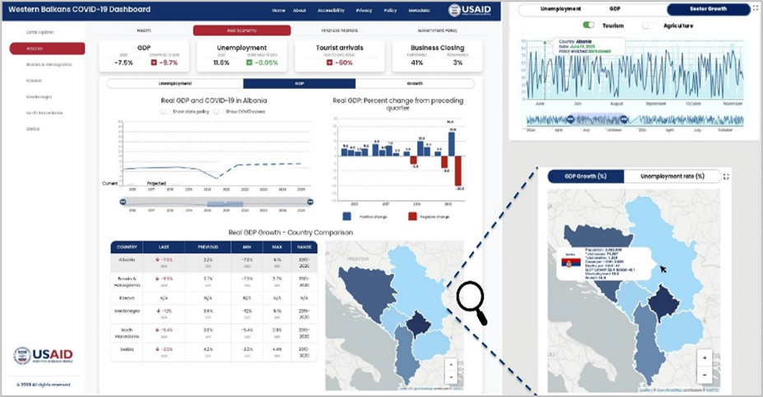
ENGINES OF GROWTH
Quarterly Updates (Y3 Q2)
Compile relevant available data on the transformative effects of the COVID-19 crisis
EoG developed a data dashboard to centralize information from multiple sources on health, real economy, financial markets, and government policy to track the ongoing impact of COVID-19 and the recovery from the pandemic. USAID and regional stakeholders use the dashboard to design programs and policies to support these economies. In this quarter all data sources for the dashboard were updated. The AMU team will put together short write ups that interpret data to share with regional missions as part of EoG's regular outreach and communication strategy.

Slide 73
ENGINES OF GROWTH
Quarterly Updates (Y3 Q2)
Women’s Economic Empowerment
EoG strengthens W-SMEs to improve their ability to grow and seek new finance by addressing key obstacles to their growth in the area of market and product development.
Digital Markets: A Funding Opportunities Notice was launched to seek solutions to expand W-SMEs’ access to digital markets and virtual marketplaces and to implement digital marketing strategies. Forty-six applications were received, and six applicants were shortlisted for the co-creation stage.
TBASPs: EoG launched a P4R activity to support W-SMEs to obtain market standards and certificates to access new markets. EoG delivered the first workshop for 34 TBASPs from all six Western Balkan countries on March 2, 2022. TBASP services will be paid by EoG at a fixed rate once the service is delivered to W-SME clients.

Slide 74
ENGINES OF GROWTH
Quarterly Updates (Y3 Q2)
Implementation Challenges | Solutions
W-SMEs loan sizes are smaller. The BASP fee structure provides the highest incentives for larger loan sizes. Therefore, BASPs tend to target larger loan sizes since the effort to acquire a smaller loan is more or less equivalent to larger loans. | Increase incentive fee structure for BASPs that secure smaller loans for W-SMEs.
Businesses are feeling the strain of post-COVID market disruptions and the war in Ukraine. Increased energy costs and disruptions to supply chains are impacting businesses. Imports and exports to Ukraine have slowed down or stopped completely. Some WB companies that sell their products to Russia and Ukraine now have to find new markets. | Support and expand the BASP network which helps SMEs access more affordable finance or restructure their existing loans to obtain more favorable terms.
Co-creation processes leave less time for implementation. New financing instruments require time to be designed and implemented before significant results can be achieved. EoG ends in Sept 2024. Given the limited time remaining, EoG has been forced to be more conservative when selecting and supporting new financing instruments. | Consider an extension for the EoG Activity to allow time for new financial instruments to be developed and release capital. At the same time, increase awareness amongst SMEs about the new financing products and services piloted under the EoG Activity.

Slide 75
ASIA – SOCIAL PROTECTION (SP)
Activity summary: Improve access to financial and social protection for vulnerable women in Asia
Objectives
Improve evidence for best practices in social protection and assess possible interventions for vulnerable female workers.
Co-develop and launch platforms incorporating innovations, including the use of blended finance to mobilize the private sector and promote affordability, ease of use, and sustainability of SP interventions.
Monitor and evaluate SP interventions for impact​ by measuring use, paid employment, education and health outcomes, and economic empowerment.
Projected LOP budget of USD4 M Seeking at least 4:1 private sector matching of USAID’s funding
Sep 2020 – TBD
Bangladesh, Indonesia, Philippines (Phase 1b)

Slide 76
ASIA – SOCIAL PROTECTION
Quarterly Updates (Y3 Q2)
This quarter, CATALYZE Asia Social Protection focused its efforts on developing high-impact activities that advance the economic empowerment, health, and education of vulnerable populations in Bangladesh and the Philippines.
In collaboration with the USAID/Bangladesh Mission, CATALYZE developed a potential intervention targeted at increasing the retention and school completion of adolescent girls. Alignment with Ministry of Education priorities has closely guided the process, and potential local partners have already been identified.
In close collaboration with USAID/Philippines, CATALYZE finalized the preparation of an in-country co-creation event that will select the final features of an activity around the transition to sustainable work and access to health services by conditional cash transfer recipients. The workshop is scheduled for the end of April 2022.
Due to shifting priorities at the partner government agency BPJS-K in Indonesia, USAID suggested putting proposed activities around health insurance enrollment on hold until further clarification is obtained from the agency. The Mission has been active in identifying additional areas of focus for CATALYZE.
CREDIT: UN WOMEN ASIA AND PACIFIC

Slide 77
ASIA – SOCIAL PROTECTION
Quarterly Updates (Y3 Q2)
Implementation Challenges | Solutions
Competing for Mission attention given complex priorities (COVID-19, political changes, climate crises, etc.). | The CATALYZE team has identified dedicated contacts in USAID Missions that can sustain continuous relations and communications and carefully navigate changes in priorities.
Adjusting to shifts in priorities of government counterparts. | Our team is developing networks of local partners who can provide informed perspectives on drivers of policy shifts, and closely coordinate with relevant Mission offices on messaging with government counterparts
Attracting private capital for social protection activities may be seen as part of public sector mandates. | Team is actively looking for sources of private capital that are aligned with social protection goals and has already connected with potential sources.

Slide 78
USAID CATALYZE
Spotlight
CREDIT: ADAM KOHN, COURTESY OF FLICKR CREATIVE COMMONS

Slide 79
SPOTLIGHT: CATALYZE PERU
Adding Value through Access to Finance in Remote Regions
Caja Huancayo was one of the first FIs to join CATALYZE Peru's Results-Based Incentive Program, which allows FIs to minimize their risk in growing their portfolio in under-served regions, such as Satipo, Peru. Satipo belongs to the Junín region, located in the central Peruvian jungle and part of the Apurímac, Ene, and Mantaro River Valley (VRAEM), one of the most conflict-ridden and undeveloped areas of the country, with high poverty rates (31.40%) and poor communication services due to its difficult geographic access. The main economic activity is agriculture, with crops such as cocoa, coffee, pineapple, oranges, and coca leaves (most of which are used for illicit purposes).
Edith Poma, 32, owns a small bodega in the Nueva Esperanza community in Satipo. As a Caja Huancayo client, Poma recently obtained a loan to start a complementary business.
"Now we want to set up a ‘KasNet’ agent. There are no banks or ATMs in our area, and I am sure we will have more clients with this service," Poma says with certainty. KasNet is a local Peruvian network typically found at small, independent stores that allows customers to pay bills and perform basic financial services in areas where there are no banks.
“Nueva Esperanza is a populated center, located about 45 minutes from the center of the city, so providing a multi-bank agent service will be very much appreciated,” she explains. Poma's business is now more profitable and will soon generate employment as she now requires one or two assistants to help serve her customers.
Photo: CATALYZE Perú
"Being able to access a loan is very important because without finance we cannot grow. It is necessary to continue implementing mechanisms that facilitate access to capital for entrepreneurs.”
– Edith Poma (left)

Slide 80
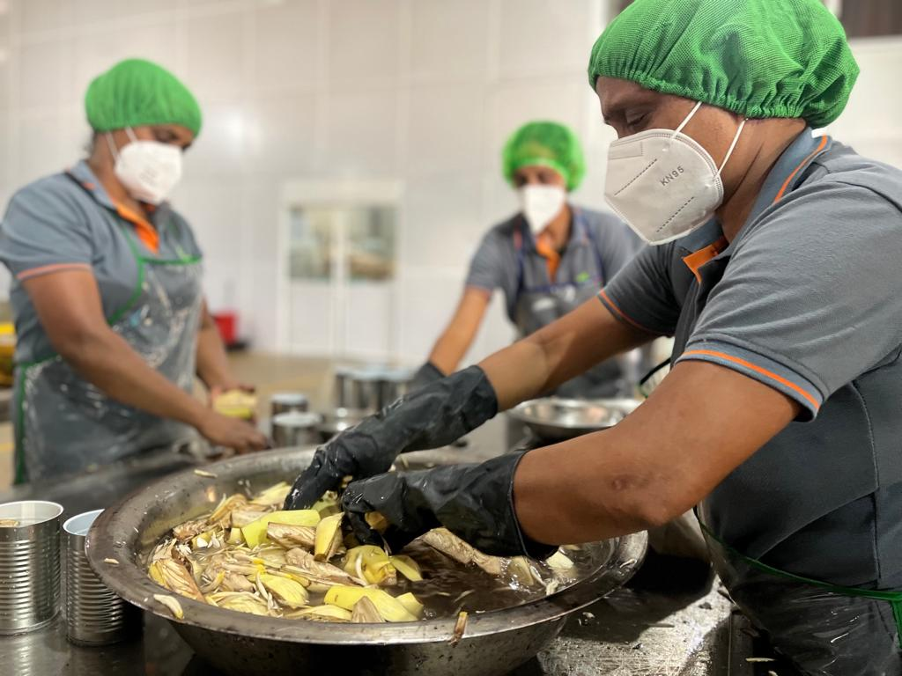
SPOTLIGHT: PRIVATE SECTOR DEVELOPMENT – SRI LANKA
Helping SMEs weather the COVID-19 pandemic
Worga Naturals, a Sri Lankan organic super-fruit specialist company that supplies raw material to the export market and export processors, works to ensure a more equitable share of profits among more than 100 rural organic farmers through ethical and fair trading. It employs 50 people, 90% of whom are women. PSD provided a USD53,497 grant to Worga Naturals to expand exports of their organic vegan food range. The grant enabled the company to:
Train 116 farmers on productivity improvement and food quality. The farmers were trained to strengthen the supply chain, enhancing the relationship with Worga Naturals, and increase capacity.
Increase production capacity through investment in an advanced can seamer and labeling machine (and for the European market, a vibrating siever). Production capacity increased from less than 1,500 units per day to 5,000-5,200 units per day within three months from purchasing the machinery through PSD grant and assistance.
Expand laboratory testing for innovative product requests from buyers and develop value-added products to minimize food waste. The new machinery helped Worga increase quality of products, resulting in a drastic reduction in waste and an increase in production efficiency.
By March 31, 2022, Worga Naturals showed an increase in annual revenue of USD130,870 and had recruited four female and three male employees despite the COVID-19 pandemic and the economic crisis prevailing in the country.
Photo: Ishani Jayamaha

Slide 81
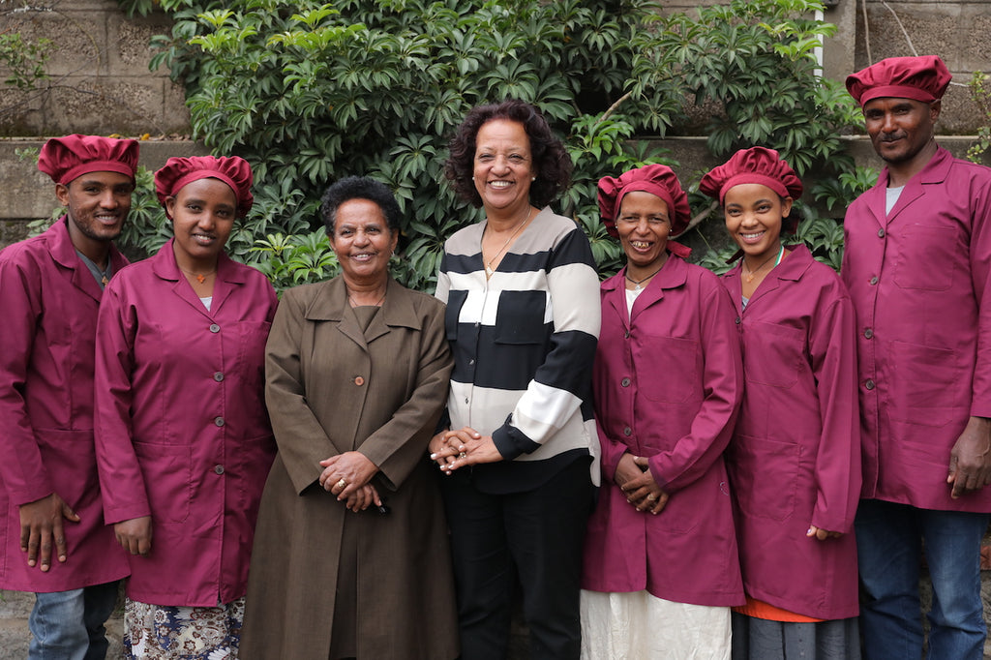
SPOTLIGHT: MS4G
Strengthening Enterprise Ecosystem
Founded by Ms. Tejnesh and her two children, Arki Agro produces about 17 baltena (Ethiopian traditional condiments), providing high quality organic food to the local and export markets.
Arki is one of the 100 SMEs supported through the MS4G BASPs P4R mechanism. In 2021, Audacia Consulting was contracted to conduct a diagnostic assessment and implement the recommended activities to increase the sales and revenue of the enterprise by 10% within one year of assistance. The BASP adds value to enterprises by providing strategic guidance, streamlining business processes, and advising companies on structure to enhance performance.
“We started our business in my home and even through we wanted to expand we did not know how,” said Tejnesh. “Audacia’s support in marketing, optimizing our administration functions, and loan facilitation is opening new doors, allowing us to grow and explore expansion possibilities.”
Arki Agro's founder Ms. Tejnesh (middle) and employees. Photo: arkifoods.com

Slide 82
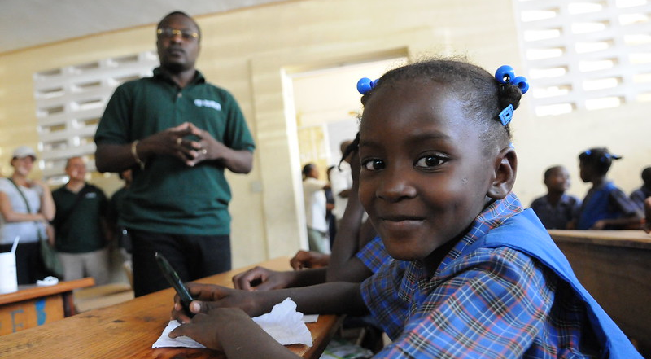
CATALYZE Y3 Q2 Report Submission Date: April 29, 2022 Contract No: 7200AA19C00080
Submitted by:
Amanda Fernandez Chief of Party/Executive Director, CATALYZE
Palladium 1331 Pennsylvania Ave NW Washington DC 20004 CATALYZE@thepalladiumgroup.com
This document was produced by Palladium for review by the US Agency for International Development. The views expressed in this document do not necessarily reflect the views of the US Agency for International Development or the United States Government.
CREDIT: USAID’S ENVISION PROJECT / IMA WORLD HEALTH

